Slide 1
Microsoft Recommenders: Best Practices for Production-Ready Recommendation Systems
Le Zhang (co-authored with Andreas Argyriou and Miguel Fierro)
Microsoft
Contributors:
Scott Graham, Nikhil Joglekar, Jianxun Lian, Jun Ki Min, Jeremy Reynolds, Tao Wu, Xing Xie et al.
https://github.com/microsoft/recommenders/blob/master/AUTHORS.md

Slide 2
Notes:
The AI transformation
Making AI real for customers
How does AI help you? How can you use AI to enable your business today? We have 3 core scenarios that our customers are using today to transform their businesses with AI.
First, we have conversational or digital agents. By 2025, 95% of customer interactions will take place via bots. Bots are a crucial customer engagement tool to build customer loyalty and a competitive advantage for businesses.
Second, we have intelligent apps. Intelligent Apps is about the massive shift around developers and enterprises creating the business apps of the future built around intelligence and data. 75% of apps will be infused with AI by end of 2018.
Third is about transforming core business processes with AI. Every business process in every industry will be transformed by AI. Just as software became the key competitive advantage for companies across industries – the use of AI to get smarter, more agile, and get to market faster will be critical.

Slide 3
Motivations
Limited references and guidance for building recommendation systems at scale to support enterprise grade scenarios
Existing packages focus on specific aspects of recommendations, and may not be compatible with each other
Recommender research is lack of pragmatic knowledge about best practices in engineering
Building an end-to-end pipeline from scratch without references can be time-consuming

Slide 4
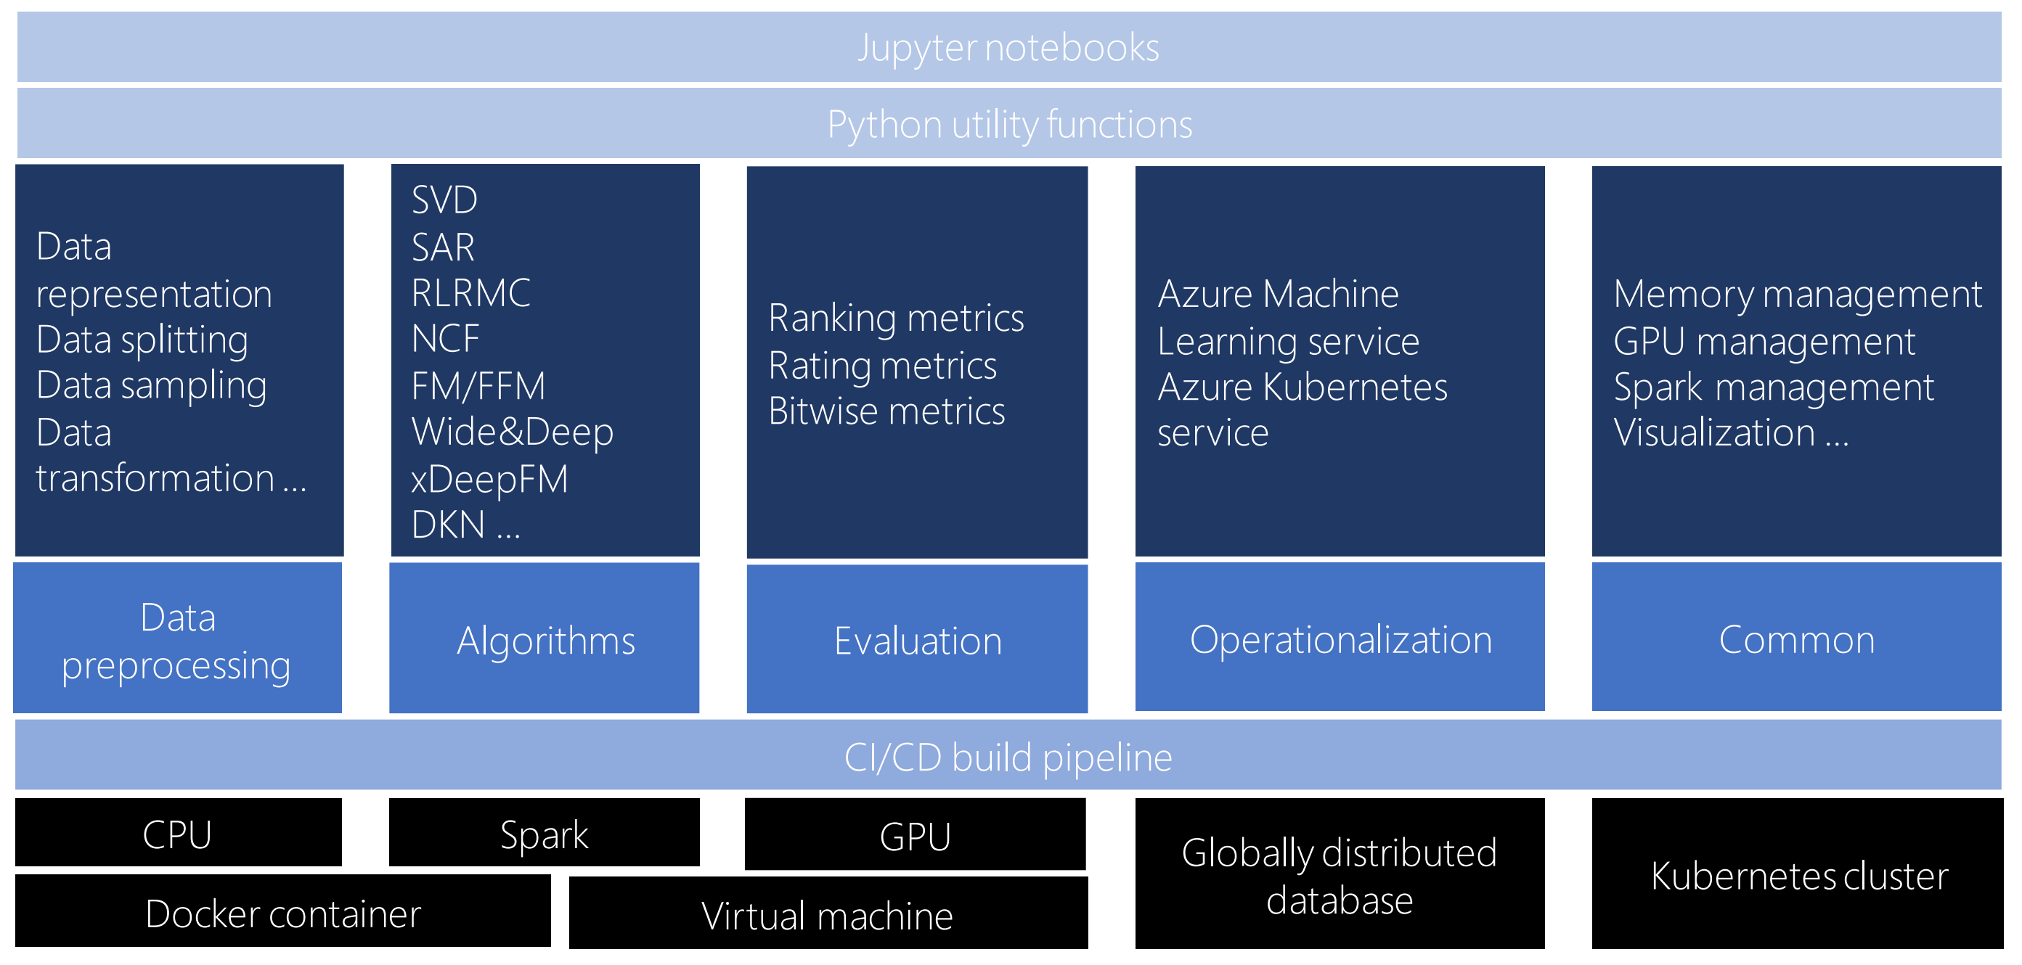
Microsoft Recommenders
https://github.com/Microsoft/Recommenders

Slide 5
Best Practices In Recommendation Systems
Use case-oriented selection of algorithms
Evidence-based software design methodology
Reproducible and generalizable interfaces and tools for building recommenders
Extensive building pipeline for testing
Collaborative platform for researchers, developers, and scientists

Slide 6
Lessons Learnt From Building Real-world Systems
Model retraining and online training
Hyperparameter tuning
Real-time serving
Heterogeneous computing resources
Health status monitoring
Correlation between offline and online performance
Business rules

