Slide 1
Building Production-Ready Recommendation Systems at Scale with Microsoft/Recommenders
Andreas Argyriou
Microsoft, Azure Global
Contributors:
Miguel Gonzalez-Fierro, Scott Graham, Nikhil Joglekar, Jianxun Lian, Jun Ki Min, Jeremy Reynolds, Tao Wu, Xing Xie, Le Zhang et al.
https://github.com/microsoft/recommenders/blob/master/AUTHORS.md

Slide 2
Objective
“Taking recommendation technology to the masses”
Helping researchers and developers to quickly select, prototype, demonstrate, and productionize a recommender system
Accelerating enterprise-grade development and deployment of a recommender system into production
In this talk
Overview of recommendation technologies
State-of-the-art academic research in recommendation algorithms
Best practices in developing recommender systems

Slide 3
Recommendation Systems in Modern Business and Academic Research
“35% of what consumers purchase on Amazon and 75% of what they watch on Netflix come from recommendations algorithms”
McKinsey & Co

Slide 4
Recommendations Everywhere
Notes:
The AI transformation
Making AI real for customers
How does AI help you? How can you use AI to enable your business today? We have 3 core scenarios that our customers are using today to transform their businesses with AI.
First, we have conversational or digital agents. By 2025, 95% of customer interactions will take place via bots. Bots are a crucial customer engagement tool to build customer loyalty and a competitive advantage for businesses.
Second, we have intelligent apps. Intelligent Apps is about the massive shift around developers and enterprises creating the business apps of the future built around intelligence and data. 75% of apps will be infused with AI by end of 2018.
Third is about transforming core business processes with AI. Every business process in every industry will be transformed by AI. Just as software became the key competitive advantage for companies across industries – the use of AI to get smarter, more agile, and get to market faster will be critical.

Slide 5
Recommendations Everywhere
Brand/news/product recommendations
Business metric prediction
Customer segmentation and personalization
Indirectly drive revenue by increasing customer engagement, networking effect etc.
Directly drive revenue through ad clicks, internet traffic etc.
Indirectly drive revenue by precisely reaching customers with market campaign or product.
Notes:
The AI transformation
Making AI real for customers
How does AI help you? How can you use AI to enable your business today? We have 3 core scenarios that our customers are using today to transform their businesses with AI.
First, we have conversational or digital agents. By 2025, 95% of customer interactions will take place via bots. Bots are a crucial customer engagement tool to build customer loyalty and a competitive advantage for businesses.
Second, we have intelligent apps. Intelligent Apps is about the massive shift around developers and enterprises creating the business apps of the future built around intelligence and data. 75% of apps will be infused with AI by end of 2018.
Third is about transforming core business processes with AI. Every business process in every industry will be transformed by AI. Just as software became the key competitive advantage for companies across industries – the use of AI to get smarter, more agile, and get to market faster will be critical.

Slide 6
Challenges
Limited resources
Fragmented solutions
Fast-growing area
There are limited references and guidance on how to build a recommender system at scale in order to support enterprise-grade scenarios
Off-the-shelf packages / tools / modules are fragmented, not scalable and not well compatible with each other
New algorithms appear every day – not many people have expertise in implementing and deploying state-of-the-art recommenders

Slide 7
History
2010 (Various data competitions)
Hybrid models with machine learning
LR, FM, GBDT, etc.
Pair-wise ranking
1990s (Tapestry, GroupLens)
Content based filtering
Collaborative filtering
CB
Explainable recommendation
Knowledge enhanced recommendation
Reinforcement learning
Transfer learning
…
FM
ML
DL
CF
2006 (Netflix prize)
Factorization-based Models
SVD++
2015 (Deep learning)
Flourish with neural models
PNN, Wide&Deep, DeepFM, xDeepFM, etc.
Notes:
1990s
Using collaborative filtering to weave an information tapestry, Communications of the ACM, 1992, citation 4496
GroupLens: an open architecture for collaborative filtering of netnews, CSCW, 1994
Recommender systems, Communications of the ACM, 1997, citation 4534
Item-based collaborative filtering recommendation algorithms, WWW2001, citation 7541
2006
Restricted Boltzmann machines for collaborative filtering, ICML 2007, citation 1293
Factorization meets the neighborhood: a multifaceted collaborative filtering model. KDD 2008, citation 2382
Probabilistic matrix factorization, NIPS 2008, 2503
matrix factorization techniques for recommender systems, Computer, 2009 (8): 30-37., citation 4995
2010
Factorization machines, 2010,
The Yahoo! Music Dataset and KDD-Cup'11, Proceedings of the 2011 International Conference on KDD Cup 2011-Volume 18. JMLR. org, 2011., citation 220. In this workshop, a lot of top solutions papers are included (you can find them in this paper’s references, including some famous researchers like Weinan Zhang and Tianqi Chen)
KDD cup 2012: https://www.kaggle.com/c/kddcup2012-track1 is also about recommendation
2015
Collaborative Deep Learning for Recommender Systems, KDD2015, citation407
Session-based Recommendations with Recurrent Neural Networks, Arxiv 2015, ICLR 2016, citation 208
A Multi-View Deep Learning Approach for Cross Domain User Modeling in Recommendation Systems,www2015, citation 172
neural collaborative filtering, WWW2017, citation309
2018
drn a deep reinforcement learning framework for news recommendation
Xiting’s work

Slide 8
Microsoft/Recommenders
Microsoft/Recommenders
Collaborative development efforts of Microsoft Cloud & AI data scientists, Microsoft Research researchers, academia researchers, etc.
Github url: https://github.com/Microsoft/Recommenders
Contents
Utilities: modular functions for model creation, data manipulation, evaluation, etc.
Algorithms: SVD, SAR, ALS, NCF, Wide&Deep, xDeepFM, DKN, etc.
Notebooks: HOW-TO examples for end to end recommender building.
Highlights
~7K stars on GitHub
Featured in YC Hacker News, O’Reily Data Newsletter, GitHub weekly trending list, etc.
Any contribution to the repo will be highly appreciated!
Create issue/PR directly in the GitHub repo
Send email to RecoDevTeam@service.microsoft.com for any collaboration

Slide 9
Microsoft/Recommenders Coding Guidelines
Test Driven Development
Do not Repeat Yourself
Single Responsibility
Python and Docstrings Style
The Zen of Python
Evidence-Based Software Design
You are not going to need it
Minimum Viable Product
Publish Often Publish Early
If our code is going to fail, let it fails fast
https://github.com/Microsoft/Recommenders/wiki/Coding-Guidelines

Slide 10
Options to Try Out Microsoft/Recommenders
Details https://github.com/yueguoguo/kdd2019tutorial
Options | Prerequisite | Pros | Cons
Local machine (Linux/Windows/MacOS) | Standalone single-node Spark Miniconda Jupyter notebook | Users can use tools they are familiar with in the local machine | Limited by the environment (e.g., OS) and hardware of the local machine (e.g., GPU)
Cloud (Azure) | Azure subscription | High flexibility to run notebooks on heterogeneous environment and computing targets Experience on building a whole end2end scalable pipeline | Starts with free credits (200 USD) but will be charged after the credits are used up
Docker container | Docker | Portable and system-independent | Require Docker to be pre-installed

Slide 11
Option 1 – Local Environment
If you want to try out the code examples, do the following
In a Linux/Windows/MacOS system, open the terminal
Clone the repo by
git clone https://github.com/Microsoft/Recommenders
Create a conda environment for Python + PySpark
Go to Recommenders/scripts, and run
python scripts/generate_conda_file.py --pyspark
Create a conda environment by
conda env create -f reco_pyspark.yaml
The newly created conda environment can be registered as a Jupyter kernel for convenience of developing in Jupyter notebook.
Then, the notebooks available in the directory of Recommenders/notebooks can be launched for trials. It’s recommended to begin with the “quickstart” ones.

Slide 12
Option 2 – Azure Data Science Virtual Machine
Azure Data Science Virtual Machine
https://azure.microsoft.com/en-us/services/virtual-machines/data-science-virtual-machines/
VM with nearly all the data science and AI tools/software pre-installed
Support single-node standalone Spark, GPU acceleration (if it is a GPU machine), etc.
Remote access to Jupyter notebook from local machine
Setup
Azure subscription – it’s free!
The same as the local machine
Jupyter notebook can be directly accessed in the browser with https://<dsvm_ip_address>:8000 where user name and password are the ones for the DSVM

Slide 13
Option 3 – Docker Container
Docker should be pre-installed
Create Docker account at https://hub.docker.com/signup
Download Docker executable https://runnable.com/docker/getting-started/
Docker images are available for running the notebook examples
In the terminal of Linux/MacOS system or cmd in Windows system, pull the Recommenders Docker image that supports Python + PySpark by
docker pull yueguoguo/reco_pyspark
Run docker run --rm –p 8888:8888 yueguoguo/reco_pyspark
Open the browser and go to localhost:8888
Ideally the Recommenders folder should appear

Slide 14
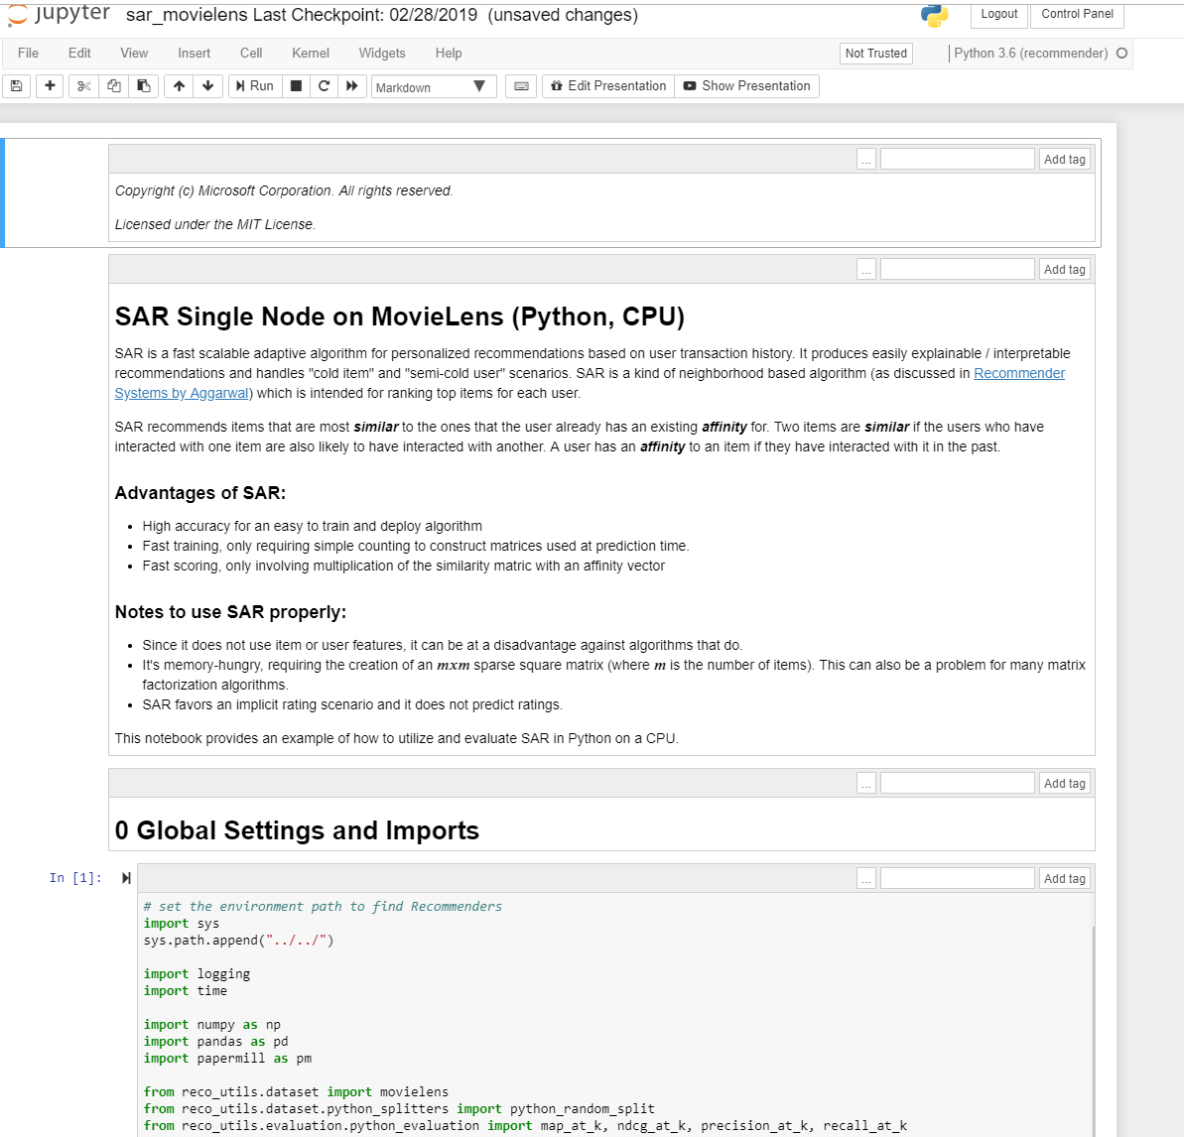
Give It A Go!
Run an example notebook
Browse to the Recommenders folder
Open the quickstart notebook
NOTE: set kernel to the one created (this is not needed for Docker method)
Content of a notebook
Intro of the algorithm
Code that
Prepares data
Develops model
Evaluates and tests model

Slide 15
Operationalization
Data
Data splitting
Data transformation
Data preparation
Algorithms
Collaborative filtering
Content-based filtering
Hybrid etc.
Evaluation
Rating
Ranking

Slide 16
Data Preparation
“Torture the data, and it will confess to anything.”
Ronald Coase

Slide 17
Operationalization
Data
Data splitting
Data transformation
Data preparation
Algorithms
Collaborative filtering
Content-based filtering
Hybrid etc.
Evaluation
Rating
Ranking

Slide 18
Data in a Recommender System
Importance of data
Recommender systems are dynamic
Multi-domain data sources can be helpful in building a high quality recommender
Challenge
How to collect
How to make ensure good quality
How to prepare and feed the processed data to the recommender algorithm
How to do things at scale

Slide 19
Data in a Recommender System
How do users interact and how is data collected?
Explicit feedback
Ratings – e.g. numerical ratings of movies on IMDB or Netflix
Survey results – e.g. survey on items with rating, satisfaction level etc.
Reviews – e.g. text reviews with positive or negative sentiment
Implicit feedback
Click / no click
Purchase / no purchase
#clicks, #purchases, #pointing links
User engagement
CTR / conversion rate / impression / attempt
Other data (features) about users and items available
Knowledge-based data (as opposed to historical data) e.g. user requirements, goals etc.

Slide 20
Data Utilities and Notebooks
Utilities
Data split (Python and PySpark)
Data transform
Negative sampling
Notebooks
notebooks/01_prepare_data/data_split.ipynb
notebooks/01_prepare_data/data_transform.ipynb

Slide 21
Evaluation
“Share our similarities, celebrate our differences”
M. Scott Peck

Slide 22
Operationalization
Data
Data splitting
Data transformation
Data preparation
Algorithms
Collaborative filtering
Content-based filtering
Hybrid etc.
Evaluation
Rating
Ranking

Slide 23
Evaluation of Recommender Systems
Evaluation is critical to recommender systems
Metrics can be similar to supervised learning
But different in terms of
Evaluation protocol
Implementation of evaluation methods
We only cover offline evaluation metrics
Basic guidelines
Hypothesis
E.g. algorithm A is better than algorithm B in terms of predicting ratings
Controlling variables
E.g. algorithm A and Algorithm B are evaluated using the same dataset and protocol
Generalization power (out of sample)
G. Shani and A. Gunawardana. Evaluating Recommendation Systems.
J. Herlocker et al, Evaluating Collaborative Filtering Recommender Systems

Slide 24
Evaluation of Recommender Systems
Properties of system
Prediction accuracy
Rating accuracy. RMSE, MAE etc. -> normalized RMSE, MAE etc. -> average RMSE, MAE etc.
Usage prediction (relevancy); precision, recall etc. -> ROC, precision-recall curves etc. -> user/global ROC
Ranking measures
Using a reference ranking: NDPM (normalized distance-based performance measure), Spearman, Kendall coefficients
Utility-based ranking: R-score, NDCG, Average Reciprocal Rank etc.
Coverage
User/item coverage. Gini index, Shannon entropy etc.
Confidence
Trust (from users’ perspective)
Novelty
Serendipity
Distance measure on item features
Diversity
M Ge et al, Beyond accuracy: evaluating recommender systems by coverage and serendipity, RecSys 2010

Slide 25
Evaluation Utilities and Notebooks
Utilities
Rating evaluation (Python and Spark)
Ranking evaluation (Python and Spark)
Notebooks
notebooks/03_evaluate/evaluation.ipynb

Slide 26
Online Evaluation
Besides offline evaluation, online evaluation is necessary in production systems (currently not covered in repo)
A/B testing is standard approach used
Metrics evaluated on separate groups of randomly selected users
Hypothesis testing needed to determine statistical significance of any improvements
Alternative (or combined with A/B testing) is reinforcement learning (e.g. multi-armed bandits)
Important considerations:
Metrics (both offline and online) should match business KPIs as closely as possible
Algorithm should optimize objective that is similar to offline evaluation metric

Slide 27
Recommendation Algorithms
“Share our similarities, celebrate our differences”
M. Scott Peck

Slide 28
Operationalization
Data
Data splitting
Data transformation
Data preparation
Algorithms
Collaborative filtering
Content-based filtering
Hybrid etc.
Evaluation
Rating
Ranking

Slide 29
Recommender Algorithms in Microsoft/Recommenders
SAR, SVD, BPR, RLRMC
FM, FFM, LightGBM,
VW
Python
Python + Spark
ALS
LightGBM
Wide & Deep,
xDeepFM
Python + GPU
NCF, FastAI, RBM
DKN
Collaborative
filtering
Content-based
filtering
Hybrid

Slide 30
Recommender Algorithms: Utilities and Notebooks
Utilities
reco_utils/recommenders
Simple Adaptive Recommendation (SAR), Surprise SVD, Neural Collaborative Filtering, xDeepFM etc.
Notebooks
notebooks/02_model/sar_deep_dive.ipynb
notebooks/02_model/als_deep_dive.ipynb
notebooks/02_model/ncf_deep_dive.ipynb
notebooks/00_quick_start/xdeepfm_criteo.ipynb
etc.
Hyperparameter tuning (using Azure Machine Learning, NNI or Spark MLLib)
notebooks/04_model_select_and_optimize

Slide 31
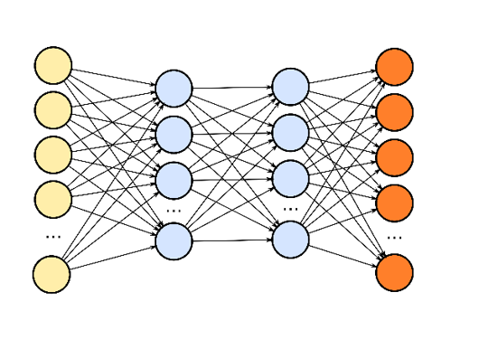
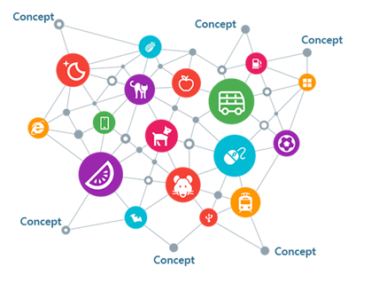
Microsoft Research
Deep learning based user modeling
Deep learning based recommendation
user
Explainable recommendation
Item
Knowledge enhanced recommendation

Slide 32
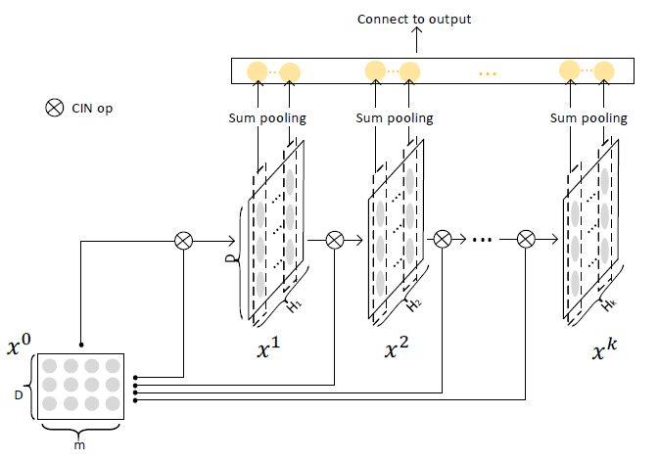
Extreme Deep Factorization Machine (xDeepFM)
Compressed Interaction Network (CIN)
Hidden units at the k-th layer:
Properties
Compression: reduce interaction space from $O(mH_{k−1})$ down to $O(H_{k})$
Keep the form of vectors
Hidden layers are matrices, rather than vectors
Degree of feature interactions increases with the depth of layers (explicit)
m: # fields in raw data
D: dimension of latent space
$H_{k}:$ # feature maps in the k-th hidden layer
$x^{0}$: input data
$x^{k}$: states of the k-th hidden layer
Jianxun Lian et al, Combining explicit and implicit feature interactions for recommender systems, KDD 2018

Slide 33
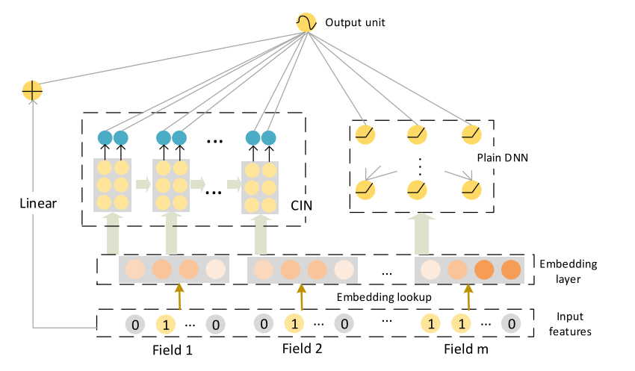
Extreme Deep Factorization Machine (xDeepFM)
Proposed for CTR prediction
Low-order and high-order feature interactions:
Linear: linear and quadratic interactions (low order)
DNN higher order implicit interactions (black-box, no theoretical understanding, noise effects)
Compressed Interaction Network (CIN)
Compresses embeddings
High-order explicit interactions
Vector-wise instead of bit-wise
Jianxun Lian et al, Combining explicit and implicit feature interactions for recommender systems, KDD 2018
Notes:
FM can extend to arbitrary order of interactions but incorporating useless features may generate noise.
DNN introduced hybrid approach but it models the features in an implicit way. Also, it models features at a bit-wise level
CIN is similar to RNN and CNN

Slide 34
Query Log based User Modeling
gifts for classmates
groom to bride gifts
cool math games
tie clips
mickey mouse cartoon
philips shaver
shower chair for elderly
lipstick color chart
presbyopic glasses
womans ana blouse
costco hearing aids
Dior Makeup
Chuhan Wu, Fangzhao Wu, Junxin Liu, Shaojian He, Yongfeng Huang, Xing Xie, Neural Demographic Prediction using Search Query, WSDM 2019

Slide 35
Query Log based User Modeling
Different words may have different importance
birthday gift for grandson
central garden street
google
my health plan
medicaid new York
medicaid for elderly in new York
alcohol treatment
amazon.com
documentary grandson
youtube
Different records have different informativeness
Neighboring records may have relatedness, while far ones usually not
The same word may have different importance in different contexts

Slide 36
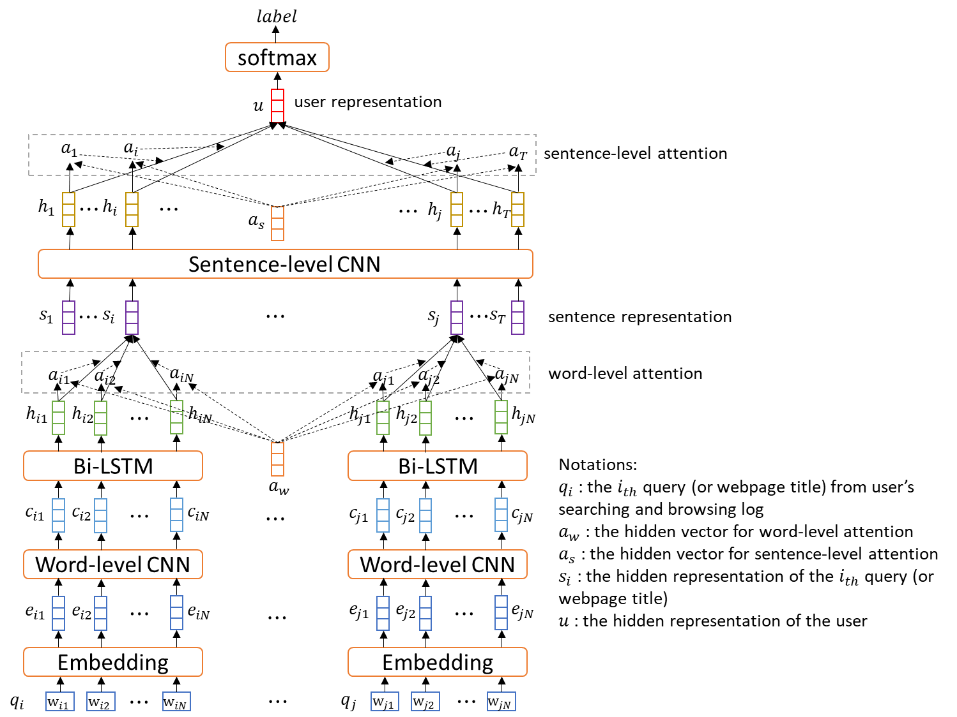
Query Log based User Modeling

Slide 37
Explainable Recommendation Systems
Fog Harbor Fish House
1-800-FLOWERS.COM – Elegant Flowers for Lovers
Their tan tan noodles are made of magic. The chili oil is really appetizing.
However, prices are on the high side.
Transparency
Trust
Effectiveness
Persuasiveness
Readability
Model
Explainability
Presentation Quality
Notes:
Know the user is susceptible to social influence, give ratings, flowers, reviews…
Know the user will buy flowers for his lovers and like roses, refine title and images

Slide 38
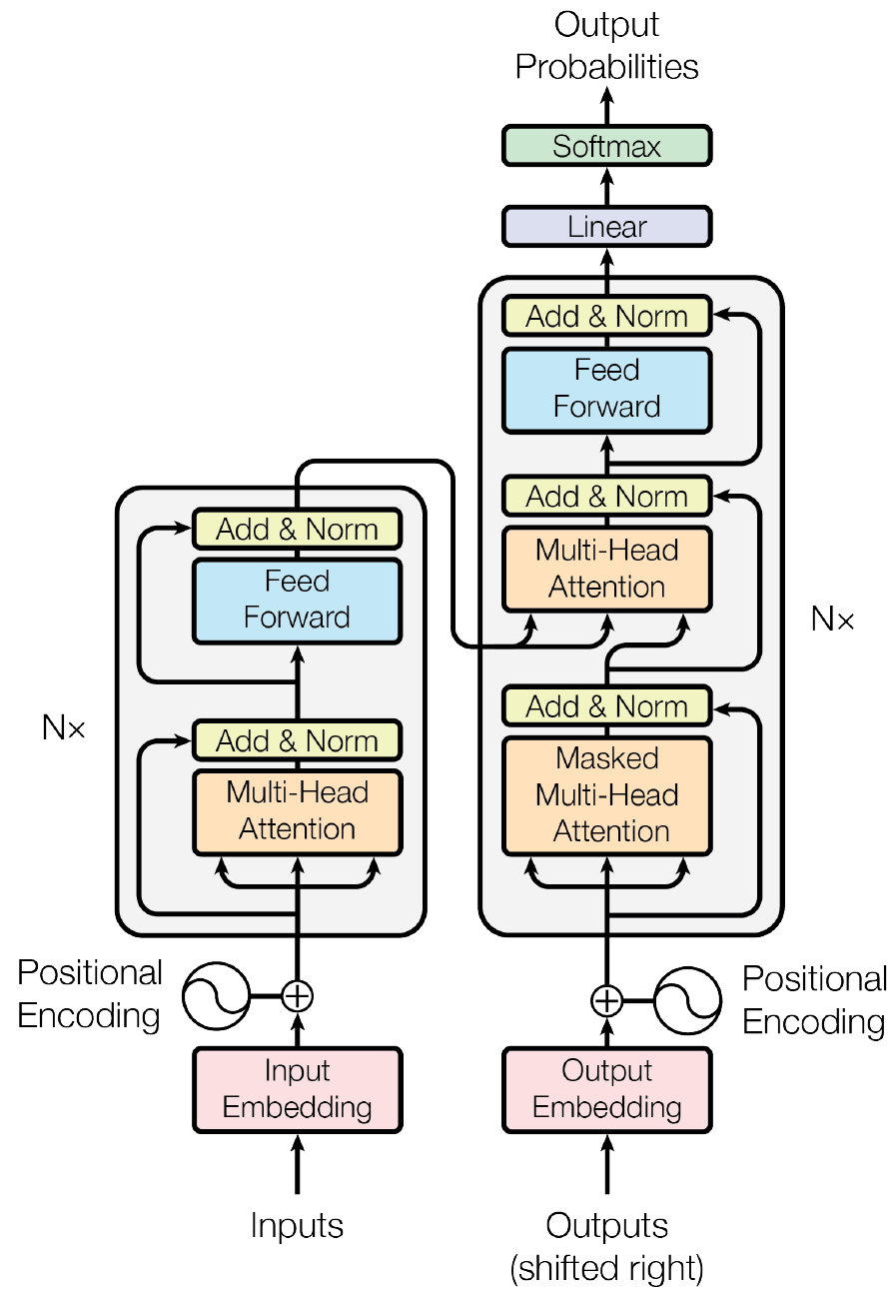
Feedback Aware Generative Model
$$E_{y_{i}\sim p\left(y_{i} | x_{i};θ\right)}r(x_{i},y_{i})$$
Traditional Seq2Seq model
$$\underset{θ}{argmax}{\prod_{i}{p(y_{i}|x_{i};θ)}}$$
Feedback aware model
$$\underset{θ}{argmax}{\sum_{i}{E_{y_{i}\sim p\left(y_{i} | x_{i};θ\right)}r(x_{i},y_{i})}}$$
$$p(y_{i}|x_{i};θ)$$
Input $x_{i}$ | Output $y_{i}$ | Reward $r(∙)$
Ad title, category, keyword, sitelink title | Ad title, Ad description, sitelink description | CTR
Ad title: Flowers delivered today
Category: Occasions & Gifts
Elegant flowers for any occasion. 100% smile guarantee!
$x_{i}$ (input)
$y_{i}$ (output)
Notes:
Compared with traditional seq2seq model that optimizes the overall probability, our feedback-aware model optimizes the expected reward we get.
Here, we use CTR as the reward.
As a result, explanations with higher CTR has larger probability to be generated.

Slide 39
Example Results
The model has the ability to generate persuasive phrases
Input AdTitle | job applications online
Output AdDescriptions | New: job application online. Apply today & find your perfect job!
 | Now hiring - submit an application. Browse full & part time positions.
 | 3 open positions left -- apply now! Jobs in your area
 | Open positions left -- apply now! Job application online.
 | 7 open positions left -- apply now! Jobs in your area
 | Sales positions open. Hiring now - apply today!
The model can differentiate similar inputs
Diversified results
Input AdTitle | US passport application
Output AdDescriptions | Find US passport application and related articles. Search now!
 | Quick & easy application. Apply for your passport online today!
 | Quick & easy application. Find government passport application and related articles.
 | Government passport application. Quick and easy to search results!
 | Start your passport online today. Apply now & find the best results!
 | Open your passport online today. 100% free tool!
Notes:
Ads on Outlook.com/MSN: 1,040,403 (AdTitle + Category) -> AdDescription training samples

Slide 40
End-to-end example
“The best way to predict the future is to invent it.”
Alan Kay

Slide 41
Operationalization
Data
Data splitting
Data transformation
Data preparation
Algorithms
Collaborative filtering
Content-based filtering
Hybrid etc.
Evaluation
Rating
Ranking

Slide 42
Operationalization Challenges
Data
Algorithm
Resources
Evaluation
O16N
Time as efforts
https://papers.nips.cc/paper/5656-hidden-technical-debt-in-machine-learning-systems.pdf

Slide 43
Operationalization Challenges
Performance specifications (latency, response time etc.)
Robustness (against dynamic change of data, requirements etc.)
Observability (pipeline health should be easy to monitor)
Resources
O16N
Time as efforts
https://papers.nips.cc/paper/5656-hidden-technical-debt-in-machine-learning-systems.pdf

Slide 44
Reference Architectures on Azure
Scalable end-to-end personalized service
Recommendations with user/item features
Serving a model for real time scoring and recommending
https://docs.microsoft.com/en-us/azure/architecture/example-scenario/ai/scalable-personalization
Real-time recommender
Collaborative filtering type recommendations
Serving recommendation results
https://docs.microsoft.com/en-us/azure/architecture/reference-architectures/ai/real-time-recommendation
In Microsoft/Recommenders:
notebooks/05_operationalize/

Slide 45
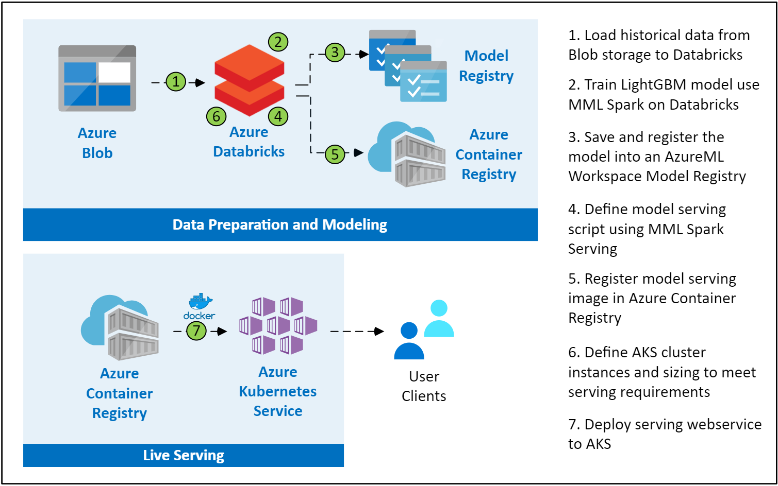
Scalable Personalization Workflow

