Slide 1
OPEN
DATA
SCIENCE
CONFERENCE
London | Nov. 19 - Nov. 22 2019

Slide 2
Taking Recommendation Systems
to The Masses
Andreas Argyriou, Miguel Gonzalez-Fierro
Microsoft Azure Global
Core contributors: Scott Graham, Nikhil Joglekar, Jun Ki Min, Jeremy Reynolds,
Le Zhang, Tao Wu. Full list at
https://github.com/microsoft/recommenders/blob/master/AUTHORS.md

Slide 3
Objective
“Democratising” the recommendation technology and filling the gap between academic research and industrial application
Helping researchers and developers to quickly select, prototype, demonstrate, and productionize a recommender system
Accelerating enterprise-grade development and deployment of a recommender system into production
Key takeaways
Systematic overview of the recommendation technology from a pragmatic perspective
Best practices in developing recommender systems and ML systems in general
How to build end to end industry-grade recommender systems

Slide 4
Recommendations Everywhere
“35% of what consumers purchase on Amazon and 75% of what they watch on Netflix come from recommendations algorithms” McKinsey & Co
Notes:
The AI transformation
Making AI real for customers
How does AI help you? How can you use AI to enable your business today? We have 3 core scenarios that our customers are using today to transform their businesses with AI.
First, we have conversational or digital agents. By 2025, 95% of customer interactions will take place via bots. Bots are a crucial customer engagement tool to build customer loyalty and a competitive advantage for businesses.
Second, we have intelligent apps. Intelligent Apps is about the massive shift around developers and enterprises creating the business apps of the future built around intelligence and data. 75% of apps will be infused with AI by end of 2018.
Third is about transforming core business processes with AI. Every business process in every industry will be transformed by AI. Just as software became the key competitive advantage for companies across industries – the use of AI to get smarter, more agile, and get to market faster will be critical.

Slide 5
Recommendations Everywhere
Brand/news/product recommendation
Business metric prediction
Customer segmentation and personalisation
Indirectly drive revenue by increasing customer engagement, networking effect, etc.
Directly drive revenue through ad clicks, internet traffic, etc.
Indirectly drive revenue by precisely reaching customers with marketing campaign or product.
Notes:
The AI transformation
Making AI real for customers
How does AI help you? How can you use AI to enable your business today? We have 3 core scenarios that our customers are using today to transform their businesses with AI.
First, we have conversational or digital agents. By 2025, 95% of customer interactions will take place via bots. Bots are a crucial customer engagement tool to build customer loyalty and a competitive advantage for businesses.
Second, we have intelligent apps. Intelligent Apps is about the massive shift around developers and enterprises creating the business apps of the future built around intelligence and data. 75% of apps will be infused with AI by end of 2018.
Third is about transforming core business processes with AI. Every business process in every industry will be transformed by AI. Just as software became the key competitive advantage for companies across industries – the use of AI to get smarter, more agile, and get to market faster will be critical.

Slide 6
History
2010 (Various data competitions)
Hybrid models with machine learning
LR, FM, GBDT, etc.
Pair-wise ranking
1990s (Tapestry, GroupLens)
Content based filtering
Collaborative filtering
CB
Explainable recommendation
Knowledge enhanced recommendation
Reinforcement learning
Transfer learning
…
FM
ML
DL
CF
2006 (Netflix prize)
Factorization-based models
SVD++
2015 (Deep learning)
Flourish of neural models
PNN, Wide&Deep, DeepFM, xDeepFM, etc.
Notes:
1990s
Using collaborative filtering to weave an information tapestry, Communications of the ACM, 1992, citation 4496
GroupLens: an open architecture for collaborative filtering of netnews, CSCW, 1994
Recommender systems, Communications of the ACM, 1997, citation 4534
Item-based collaborative filtering recommendation algorithms, WWW2001, citation 7541
2006
Restricted Boltzmann machines for collaborative filtering, ICML 2007, citation 1293
Factorization meets the neighborhood: a multifaceted collaborative filtering model. KDD 2008, citation 2382
Probabilistic matrix factorization, NIPS 2008, 2503
matrix factorization techniques for recommender systems, Computer, 2009 (8): 30-37., citation 4995
2010
Factorization machines, 2010,
The Yahoo! Music Dataset and KDD-Cup'11, Proceedings of the 2011 International Conference on KDD Cup 2011-Volume 18. JMLR. org, 2011., citation 220. In this workshop, a lot of top solutions papers are included (you can find them in this paper’s references, including some famous researchers like Weinan Zhang and Tianqi Chen)
KDD cup 2012: https://www.kaggle.com/c/kddcup2012-track1 is also about recommendation
2015
Collaborative Deep Learning for Recommender Systems, KDD2015, citation407
Session-based Recommendations with Recurrent Neural Networks, Arxiv 2015, ICLR 2016, citation 208
A Multi-View Deep Learning Approach for Cross Domain User Modeling in Recommendation Systems,www2015, citation 172
neural collaborative filtering, WWW2017, citation309
2018
drn a deep reinforcement learning framework for news recommendation
Xiting’s work

Slide 7
Challenges
Limited resources
Fragmented solutions
Fast-growing area
There are limited references and guidance for building recommendation systems at scale and support enterprise-grade scenarios
Off-the-shelf packages / tools / modules are fragmented, not scalable, or not compatible with each other
New algorithms are proposed every day by researchers;
not many people have expertise to implement state-of-the-art algorithms and deploy them in recommendation systems

Slide 8
Microsoft/Recommenders
Microsoft/Recommenders
Collaborative development efforts of Microsoft Cloud & AI data scientists, researchers from Microsoft Research and academia etc.
Github url: https://github.com/Microsoft/Recommenders
Open-source (MIT license)
Contributions from the community are highly appreciated!
Create issue/PR directly in the GitHub repo
Send email to RecoDevTeam@service.microsoft.com for any collaboration
Highlights
~6500 stars on GitHub
Featured in YC Hacker News, O’Reily Data Newsletter, GitHub weekly trending list, etc.

Slide 9
Key Objectives of Recommenders
Reduce time to delivery; large efficiencies in E2E development
Lower barrier of entry
Easy scale out on the cloud
Easy-to-use and open-source

Slide 10
Core Values and Best Practices
Reusable AI Assets
Impact to the Community
Collaboration Pipeline
Industry-standard code and solutions ready for customer real-world scenarios
Acceleration of customised development of AI workloads
Attraction to world-class ML researchers and developers
6500+ stars, showcased in conferences, blogs, tech magazines etc.
Leverage resources from Microsoft and the ML community
Data-driven and customer-driven working process (evidence-based design)

Slide 11
Microsoft/Recommenders Coding Guidelines
Test driven development
Do not Repeat Yourself
Single responsibility
Python and docstrings style
The Zen of Python
Evidence-based software design
You are not going to need it
Minimum viable product
Publish often publish early
If our code is going to fail, let it fail fast
https://github.com/Microsoft/Recommenders/wiki/Coding-Guidelines

Slide 12
Repository General Components
Reco Utilities
Notebooks
Tests
Dataset loaders
Splitters
Ranking Metrics
Rating Metrics
Spark ALS (matrix factorisation)
SAR (simple collaborative filtering): Spark and Python implementations
Deep Learning algorithms from Microsoft Research
Open source frameworks: Surprise
Vowpal Wabbit
Unit tests
Integration tests
Nightly builds
Benchmarks updated every night

Slide 13
Testing
Unit, smoke and integration tests for Python files and notebooks
Automatic nightly execution
Triggered execution of unit and smoke tests for PRs
Testing of Jupyter notebooks done with Papermill https://github.com/nteract/papermill
Contributors are required to provide tests for utilities and notebooks
Testing in ML can be tricky (results are non-deterministic)

Slide 14
Options to Try Out Microsoft/Recommenders
Options | Prerequisites | Pros | Cons
Local machine (Linux/Windows/MacOS) | Standalone single-node Spark Miniconda Jupyter notebook | Users can use tools they are familiar with in the local environment | Limited by the environment (e.g. OS) and hardware resources (e.g. CPU vs. GPU, RAM etc.)
Cloud | Cloud subscription or infrastructure | High flexibility to run notebooks on heterogeneous environments and computing targets Easier to build an E2E scalable pipeline | Compute resources are not free
Docker container | Docker installation | Portable and system-independent; good for serving models | Not ideal for development / debugging

Slide 15
Option 1 – Local Environment
In a Linux/Windows/MacOS system, open the terminal
Clone the repo
git clone https://github.com/Microsoft/Recommenders
Create a conda environment; several options e.g. for Python + PySpark:
Go to Recommenders/scripts, and run
python scripts/generate_conda_file.py --pyspark
Create a conda environment by
conda env create -f reco_pyspark.yaml
The newly created conda environment can be registered as a Jupyter kernel for convenience of development in Jupyter notebooks.
Then, the notebooks available in Recommenders/notebooks can be launched. It is recommended to begin with the “quick start” ones.

Slide 16
Option 3 – Docker Container
Docker should be pre-installed
Create Docker account at https://hub.docker.com/signup
Download Docker executable https://runnable.com/docker/getting-started/
Docker images are available for running the notebook examples
In the terminal of Linux/MacOS system or cmd in Windows system, pull the Recommenders Docker image that supports Python + PySpark by
docker pull yueguoguo/reco_pyspark
Run docker run --rm –p 8888:8888 yueguoguo/reco_pyspark
Open the browser and go to localhost:8888
If all goes well, the Recommenders folder should appear

Slide 17
Basic Workflow
Similar to typical methods in machine learning:
training
validation
testing (via predictions and recommendations)
In addition need to take into account / emulate how the system will work in production (e.g. how to handle “cold” users, temporal order etc.)
Need to pay attention to “stale” data:
changing tastes
changing customer base
trends etc.

Slide 18
Basic Workflow (contd.)
Data
Recommender
Evaluator
Yes, Yes
Chrono split
DeepRec
ALS
Diversity metrics
Yes
No
Stratified split
Regression
SAR
Ranking metrics
AI pipeline
3
Yes, No
No
Yes
Timestamp split
Even richer feature set?
Similarity based?
Rating metrics
2
Random split
1
No, Yes
Content-based
collaborative filtering
1 Accuracy
2 Relevance of ranked recommendations
3 Diversity
No, Yes
No, No
Stratify? Time dependent?
Yes
User/item features?
No
User/item features?

Slide 19
Operationalization
Data
Data splitting
Data transformation
Data preparation
Algorithms
Collaborative filtering
Content-based filtering
Hybrid
Evaluation
Rating
Ranking

Slide 20
Data Preparation
“Torture the data, and it will confess to anything.”
Ronald Coase

Slide 21
Operationalization
Data
Data splitting
Data transformation
Data preparation
Algorithms
Collaborative filtering
Content-based filtering
Hybrid
Evaluation
Rating
Ranking

Slide 22
Data in a Recommender System
Importance of data
Recommendation systems are dynamic
Multi-domain data sources are helpful in building a recommender with high quality
Challenge
How to collect
How to make sure data is of good quality
How to prepare and feed the processed data to the recommender algorithm
How to do things at scale
…

Slide 23
Data in a Recommender System
How do users interact and how is data collected?
Explicit feedback
Ratings – e.g., numerical ratings of movies on IMDB or Netflix.
Survey results – e.g., survey on items with rating, satisfaction level, etc.
Reviews – e.g., text reviews with positive or negative sentiment.
Implicit feedback
Click / no click
Purchase / no purchase
#clicks, #purchases, #pointing links
User engagement
CTR / conversion rate / impression / attempt
Other data (features) about users and items available
Knowledge-based data (as opposed to historical data), e.g. user requirements, goals etc.

Slide 24
Data Utilities and Notebooks
Utilities
Data loaders (Python and PySpark)
Movielens, Criteo
Data split (Python and PySpark)
Chronological, stratified, random tc.
Data transform
Negative sampling
Notebooks
notebooks/01_prepare_data/data_split.ipynb
notebooks/01_prepare_data/data_transform.ipynb

Slide 25
Recommendation Algorithms
“Share our similarities, celebrate our differences”
M. Scott Peck

Slide 26
Operationalization
Data
Data splitting
Data transformation
Data preparation
Algorithms
Collaborative filtering
Content-based filtering
Hybrid
Evaluation
Rating
Ranking

Slide 27
Recommender Algorithms in Microsoft/Recommenders
Python
SAR, SVD, RLRMC, BPR
LightGBM
FM
Python + Spark
ALS
LightGBM
FM
Python + GPU
NCF, FastAI, RBM
DKN
xDeepFM, Wide and Deep
Collaborative
filtering
Content-based
filtering
Hybrid

Slide 28
Recommender Algorithm Utilities and Notebooks
Utilities
Simple Adaptive Recommendation (SAR)
Spark ALS
Neural Collaborative Filtering
xDeepFM etc.
Notebooks
notebooks/02_model/sar_deep_dive.ipynb
notebooks/02_model/als_deep_dive.ipynb
notebooks/02_model/ncf_deep_dive.ipynb
notebooks/00_quick_start/xdeepfm_criteo.ipynb
Hyperparameter tuning
notebooks/04_model_select_and_optimize

Slide 29
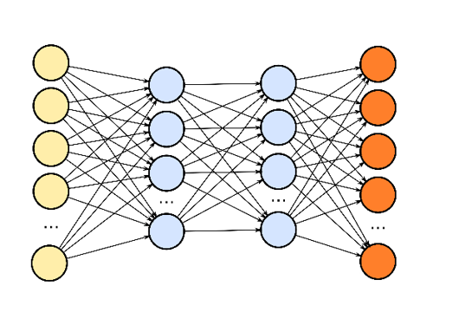
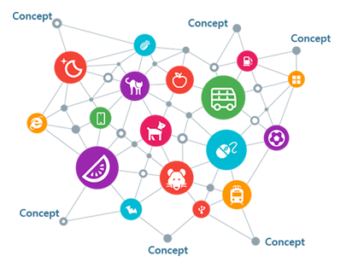
Microsoft Research
Deep learning based user modeling
Deep learning based recommendation
user
Explainable recommendation
Item
Knowledge enhanced recommendation

Slide 30
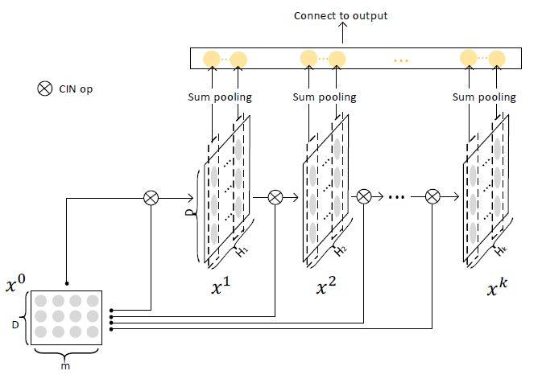
Extreme Deep Factorization Machine (xDeepFM)
Compressed Interaction Network (CIN)
Hidden units at the k-th layer:
Properties
Compression: reduce interaction space from $O(mH_{k−1})$ down to $O(H_{k})$
Keep the form of vectors
Hidden layers are matrices, rather than vectors
Degree of feature interactions increases with the depth of layers (explicit)
m: # fields in raw data
D: dimension of latent space
$H_{k}:$ # feature maps in the k-th hidden layer
$x^{0}$: input data
$x^{k}$: states of the k-th hidden layer
Jianxun Lian et al, Combining explicit and implicit feature interactions for recommender systems, KDD 2018

Slide 31
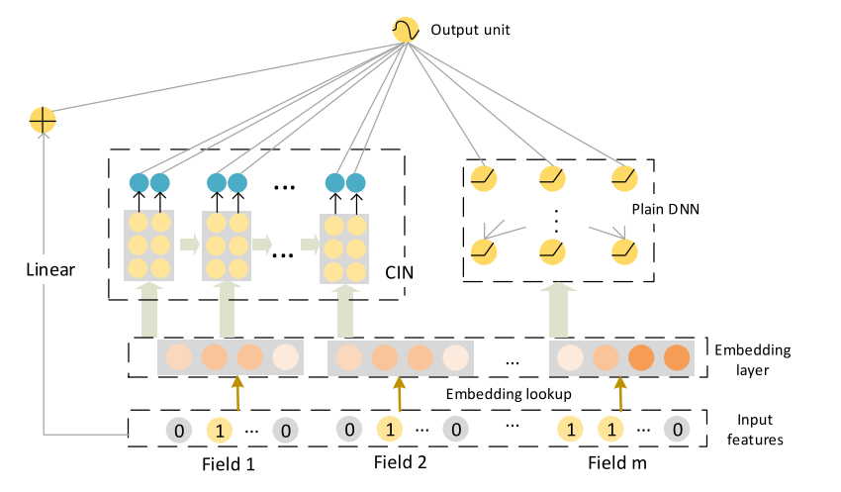
Extreme Deep Factorization Machine (xDeepFM)
Proposed for CTR prediction
Low-order and high-order feature interactions:
Linear: linear and quadratic interactions (low order)
DNN higher order implicit interactions (black-box, no theoretical understanding, noise effects)
Compressed Interaction Network (CIN)
Compresses embeddings
High-order explicit interactions
Vector-wise instead of bit-wise
Jianxun Lian et al, Combining explicit and implicit feature interactions for recommender systems, KDD 2018

Slide 32
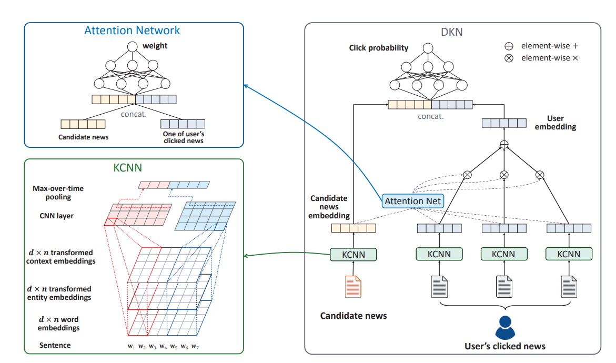
DKN: Deep Knowledge-Aware Network for News Recommendation
Content-based deep recommendation framework for click-through rate prediction
Knowledge-aware convolutional neural network (KCNN) fuses semantic-level and knowledge-level representations of news
Attention module dynamically aggregates a user’s history with respect to current candidate news
H. Wang et al, DKN: Deep Knowledge-Aware Network for News Recommendation, WWW 2018

Slide 33
Evaluation
“Share our similarities, celebrate our differences”
M. Scott Peck

Slide 34
Operationalization
Data
Data splitting
Data transformation
Data preparation
Algorithms
Collaborative filtering
Content-based filtering
Hybrid
Evaluation
Rating
Ranking

Slide 35
Evaluation
The ultimate goal of a recommendation system is to improve business KPIs such as CTR, ROI, profit, customer satisfaction
Common problem: these KPIs may not, or cannot be measured directly during training, validation and testing (offline evaluation)
Instead usually a proxy metric or a metric of the predictive power is used (precision, recall, mean squared error etc.)
Common issue: such metrics may not always correlate well with target KPIs
Offline evaluation is complemented by online evaluation (sometimes user studies)

Slide 36
Evaluation of a Recommender System
Evaluation is critical to recommender systems
Metrics can be similar to supervised learning
But are different in terms of
Evaluation protocol
Implementation of evaluation methods
We only cover offline evaluation metrics
Basic guidelines
Hypothesis.
E.g., algorithm A is better than algorithm B in terms of predicting ratings.
Controlling variables.
E.g., algorithm A and Algorithm B are evaluated by using the same dataset and protocol.
Generalisation power.
G. Shani and A. Gunawardana. Evaluating Recommendation Systems.
J. Herlocker et al, Evaluating Collaborative Filtering Recommender Systems

Slide 37
Evaluation of a Recommender System
Properties of system
Prediction accuracy
Rating accuracy. RMSE, MAE, etc. -> normalized RMSE, MAE, etc. -> Average RMSE, MAE, etc.
Usage prediction (relevancy). Precision, recall, etc. -> ROC, precision-recall, etc. -> user/global ROC.
Ranking measures.
Using a reference ranking. NDPM
Utility-based ranking. R-score, NDCG, Average Reciprocal Rank, etc.
Coverage
User/item coverage. Gini index, Shannon entropy, etc.
Confidence
Trust (from users’ perspectives)
Novelty
Serendipity
Diversity
M Ge et al, Beyond accuracy: evaluating recommender systems by coverage and serendipity, RecSys 2010

Slide 38
Evaluation Utilities and Notebooks
Utilities
Rating evaluation (Python and Spark)
Ranking evaluation (Python and Spark)
AUC, logloss
Notebooks
notebooks/04_evaluation/evaluation.ipynb

Slide 39
Q & A

