Slide 1
In Search For A Cure: Recommendation with Knowledge Graph on CORD-19
Iris Shen, Jianxun Lian, Miguel Gonzalez-Fierro, and Le Zhang
Microsoft

Slide 2
Globally, as of 12:48pm CEST, 23 August 2020, there have been 23,057,288 confirmed cases of COVID-19, including 800,906 deaths, reported to WHO.
https://covid19.who.int/?gclid=Cj0KCQjw6uT4BRD5ARIsADwJQ19jnAzaXO3sJguACQIGTi0oRYfs8q0KQiitpu5Sw2OOcqRppoqiyF0aAqCwEALw_wcB

Slide 3
Opening
The tutorial provides best practices on developing COVID-19 related academic research recommendation with the aim of the knowledge graph
You will learn
  The CORD-19 data set and COVID-19 related knowledge graph
  Graph-based recommendation techniques and implementations
  Operationalization methods for Graph database, model, and system
The tutorial content, materials, and source codes can be found in the website https://kdd2020tutorial.github.io/cord19recommender/

Slide 4
Outline
Type | Content | Duration
- | Opening | 3 min
Hands-on | Environment set up | 12 min
Hands-on | Basics of the dataset CORD-19 and the Knowledge Graph | 25 min
Hands-on | Understanding contents with the aid of the Knowledge Graph | 40 min
Hands-on | Applications of Knowledge Graph: Academic Recommender Systems | 45 min
Lecture | Operationalization of KG-based recommender system | 40 min
- | Closing and QnA | 15 min

Slide 5
Environment setup
Details about the environment set up can be found at the following link
https://aka.ms/kdd2020-covid-demo

Slide 6
Basics of CORD-19 data set and the knowledge graph
Iris Shen

Slide 7

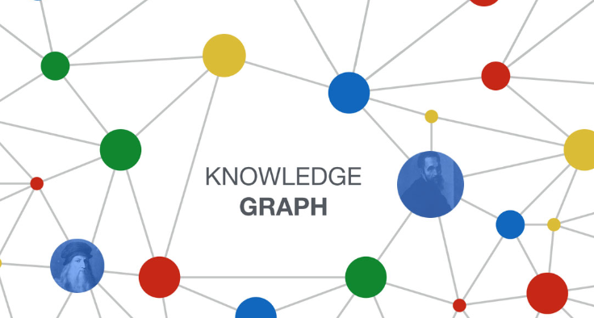




Module I - Dataset
Metadata +
Full Text Documents
Academic Knowledge Graph
Microsoft Academic Graph
(MAG)
CORD-19

Slide 8
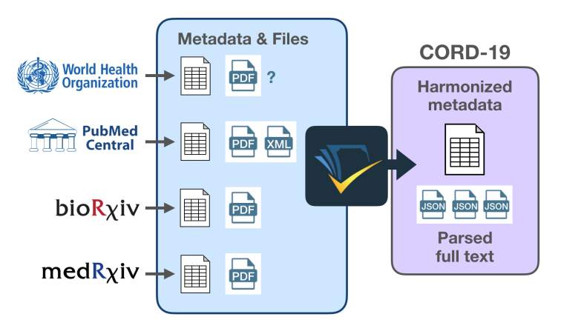
CORD-19 Dataset
WHO
  AI2 / MSR / CZI / NIH / Georgetown U
WHY
  AI – fight COVID-19
WHAT
  Meta-data
  Full text
WHEN
  Started Mar 16, 2020
  Update daily
HOW
WHERE
https://pages.semanticscholar.org/coronavirus-research
https://www.kaggle.com/allen-institute-for-ai/CORD-19-research-challenge
https://azure.microsoft.com/en-us/services/open-datasets/catalog/covid-19-open-research
Reference: Wang, Lucy Lu, et al. “CORD-19: The Covid-19 Open Research Dataset.” arXiv:2004.10706, 2020.

Slide 9
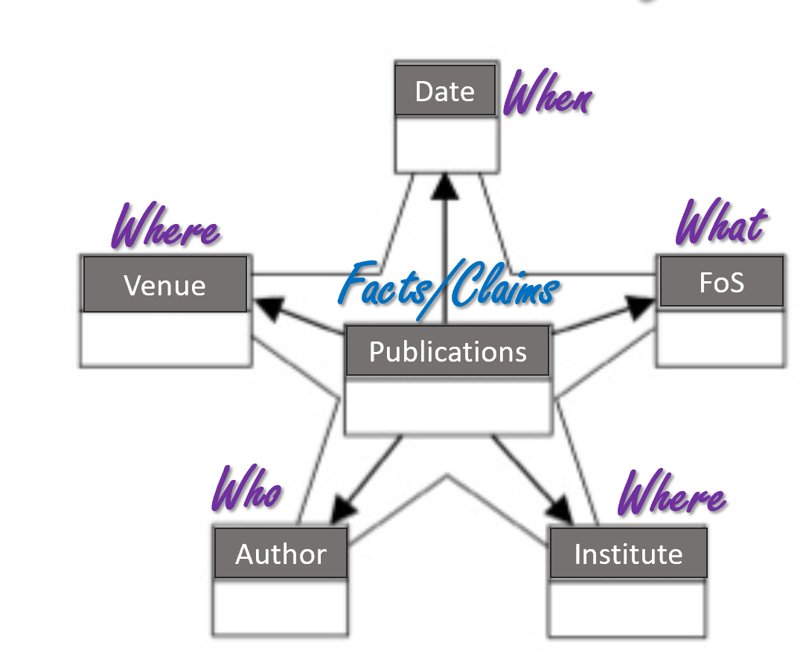
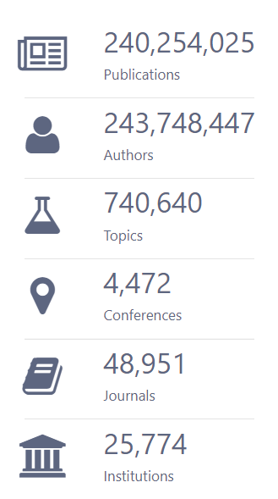
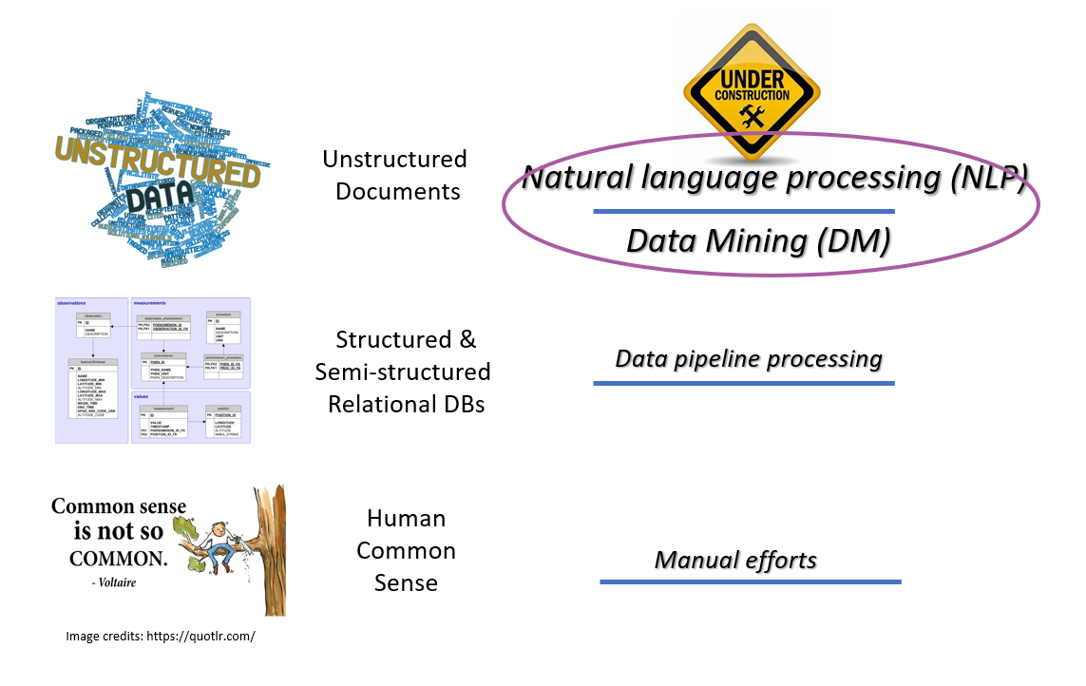
Microsoft Academic Graph (MAG)
WHO
  Microsoft Academic (MSR)
WHY
  AI – scholarly communications
HOW
WHEN
  Start from 2014
  Update weekly
WHAT
MAG 07-16-2020
version stats
Knowledge in the graph form
WHERE
Search portal: https://academic.microsoft.com/
Project: https://www.microsoft.com/en-us/research/project/microsoft-academic-graph/
Get the free graph: https://docs.microsoft.com/en-us/academic-services/graph/
References:
Sinha, Arnab, et al. “An Overview of Microsoft Academic Service (MAS) and Applications.” WWW, 2015.
Wang, Kuansan, et al. “A Review of Microsoft Academic Services for Science of Science Studies.” Frontiers in Big Data, 2019.

Slide 10
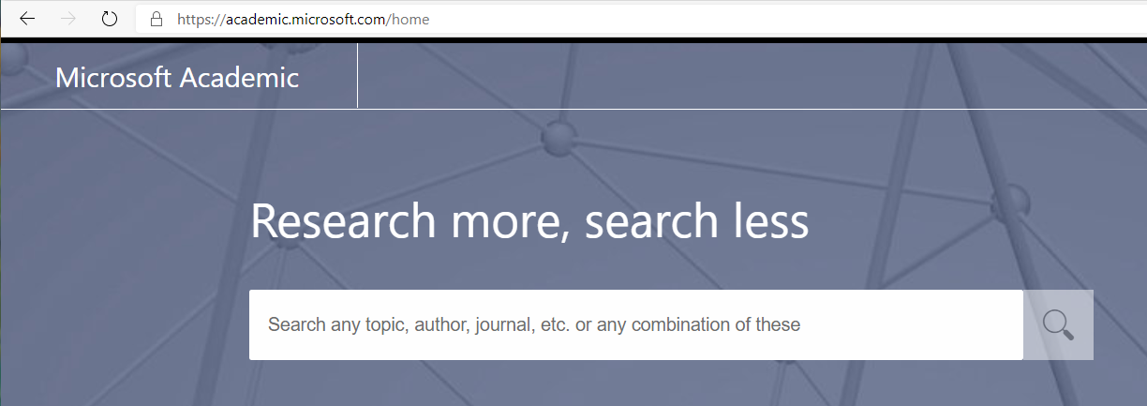
CORD-19 + MAG
WHY
  Richer Semantics
  Empower more applications
    Search
    QnA
    Content understanding / Analytics (Module 2)
    Recommendation (Module 3 + 4)
WHAT
  ~88% CORD-19 mapped to MAG
WHEN
  Update daily
HOW
  Microsoft Academic Knowledge Exploration Service (MAKES) API
Machine inference engine with
knowledge in MAG
https://academic.microsoft.com/home
MAKES References:
Wang, Kuansan, et al. “A Review of Microsoft Academic Services for Science of Science Studies.”
Frontiers in Big Data, 2019.

Slide 11
CORD-19 + MAG : How + Where
Get Cord-19 data
(Text Corpus+Metadata)
(1) PAK or MAKES
API for ID linking
CORD-19 to MAG ID mapping (A)
Module 2:
Content
Understanding
Request PAK API access or MAKES API instance
(Indexed KG/search API)
(2) PySpark Script
to get subgraph
CORD-19 MAG
Subgraph (B)
Module 3:
KG-assisted
Recommendation
Request MAG Access
(Knowledge Graph)
CORD-19 data set:
https://pages.semanticscholar.org/coronavirus-research
Option 1:
DIY
Step-by-step instruction on using (1) PEK API for dataset linking + (2) PySpark script to get CORD-19 subgraph:
https://github.com/microsoft/mag-covid19-research-examples
Blogpost on more details of Covid-19 research on MAG [how to request MAG + PAK/MAKES access]
https://www.microsoft.com/en-us/research/project/academic/articles/microsoft-academic-resources-and-their-application-to-covid-19-research
A. Get the CORD-19 to MAG paper IDs mapping:
https://github.com/microsoft/mag-covid19-research-examples/blob/master/src/data/releases.md
Option 2:
Grab the Results
B. Get the CORD-19 MAG subgraph:
https://aka.ms/kdd2020-covid-demo
C. Access the mapped CORD-19 publication via API:
https://github.com/microsoft/mag-covid19-research-examples/blob/master/src/PAK-Samples/cord-19-closure.md

Slide 12
Module I – Dataset in a nutshell
Metadata +
Full Text Documents
Academic Knowledge Graph
Microsoft Academic Graph
(MAG)
CORD-19
Small (0.1% node size)
Specific (limited sub-domains)
Large (500G / 500M nodes)
Comprehensive (all domains)
Global Knowledge

Slide 13
Understanding contents with the aid of the knowledge graph
Iris Shen

Slide 14
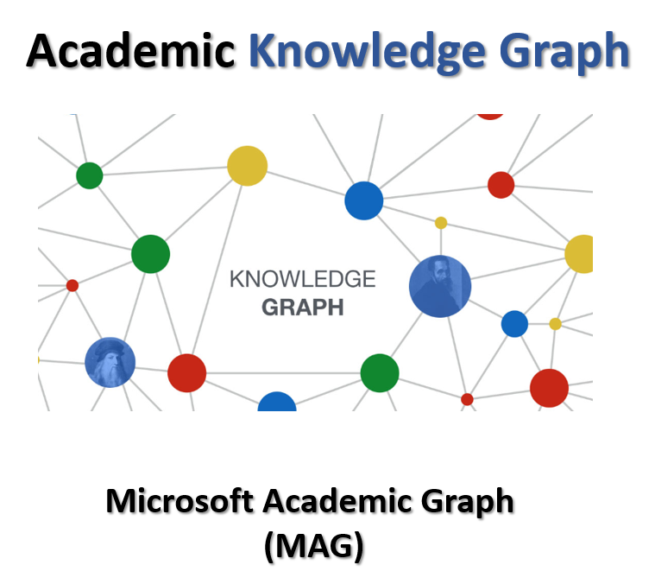
Module II – Content Understanding with the aid of KG
KG (MAG) size and schema
Language Similarity API
Content understanding / Analytics
  Publication trend? – Temporal distribution
  Where did they published? – Publishing Venue distribution
  Where did these research come from? – Geo distribution
  Were these research are conducted by small or large groups? – Team Size distribution
  What are they talking about? - Topic distribution
CORD-19

Slide 15
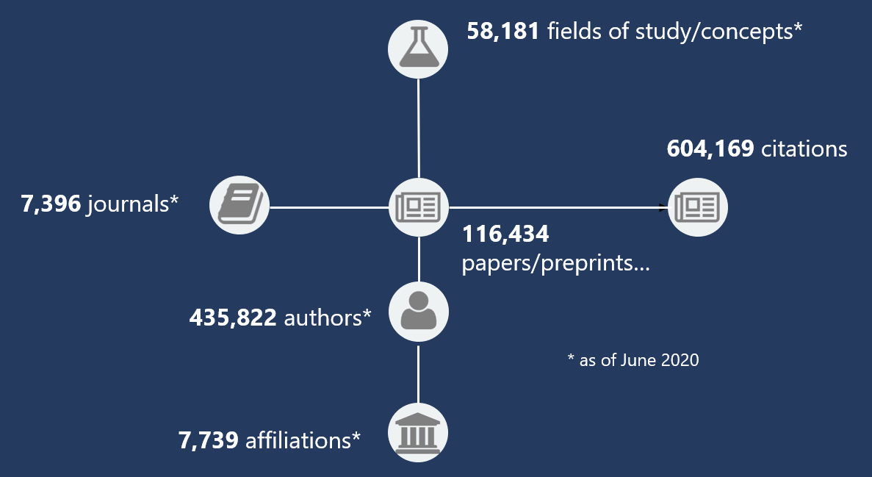
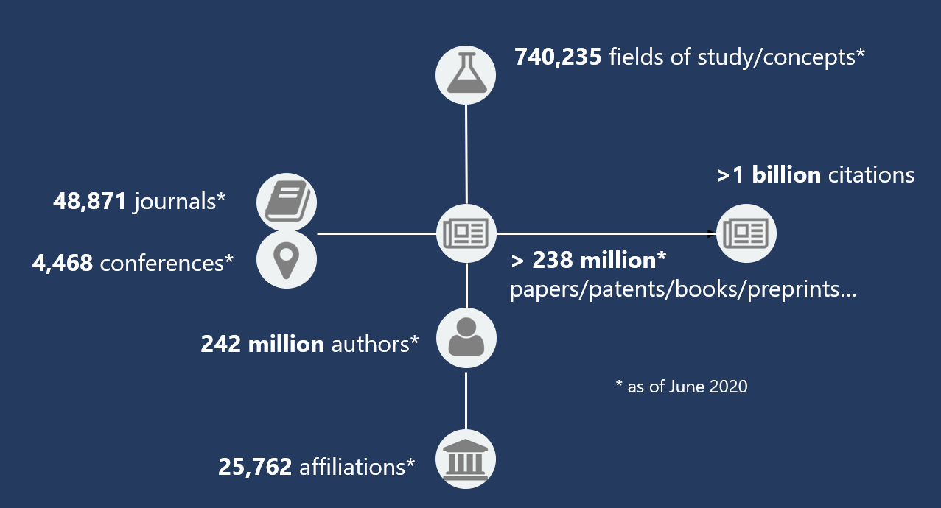
Module II – Knowledge Graph size comparison
MAG CORD-19 Subgraph
(Version: CORD-19 06/14/2020; MAG 06/05/2020)
Nodes: ~623K
Edges: ~2M
Full Microsoft Academic Graph
(MAG)
Nodes: ~480M
Edges: ~4B
Small: 0.1% node size
Specific: 7.8% topics

Slide 16
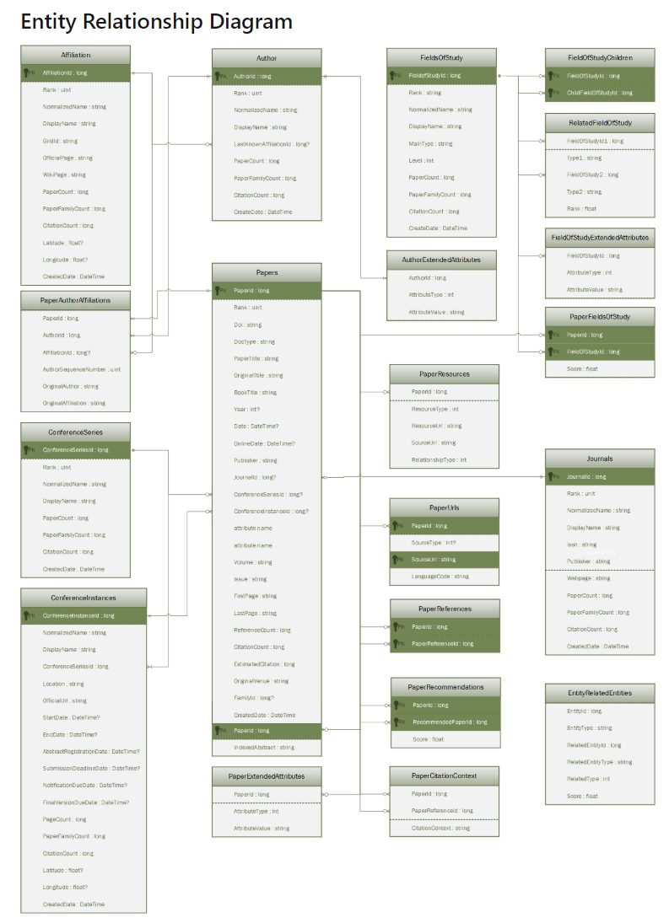
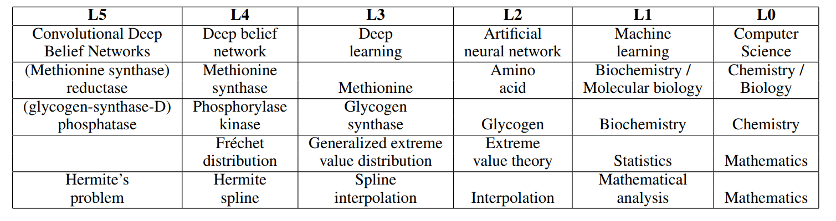
Microsoft Academic Graph Schema
https://docs.microsoft.com/en-us/academic-services/graph/reference-data-schema
        MAG Topics
  740K+ topics / fields of study
    230K+ from Wikipedia
    433K+ from UMLS (NIH, Bio-Med)
    77K+ mined from MAG corpus
  6 level auto-constructed taxonomy
    19 domain (manually-curated)
    270 sub-domain (manually-curated)
FieldOfStudy
FieldOfStudyChildren
PaperFieldsOfStudy
RelatedFieldOfStudy
4 Tables used in Module 3 KG-assisted
Recommendation
References: Shen, Zhihong, et al. “A Web-Scale System for Scientific Knowledge Exploration.” ACL, 2018.
Blogpost: Expanding concept understanding in Microsoft Academic Graph

Slide 17
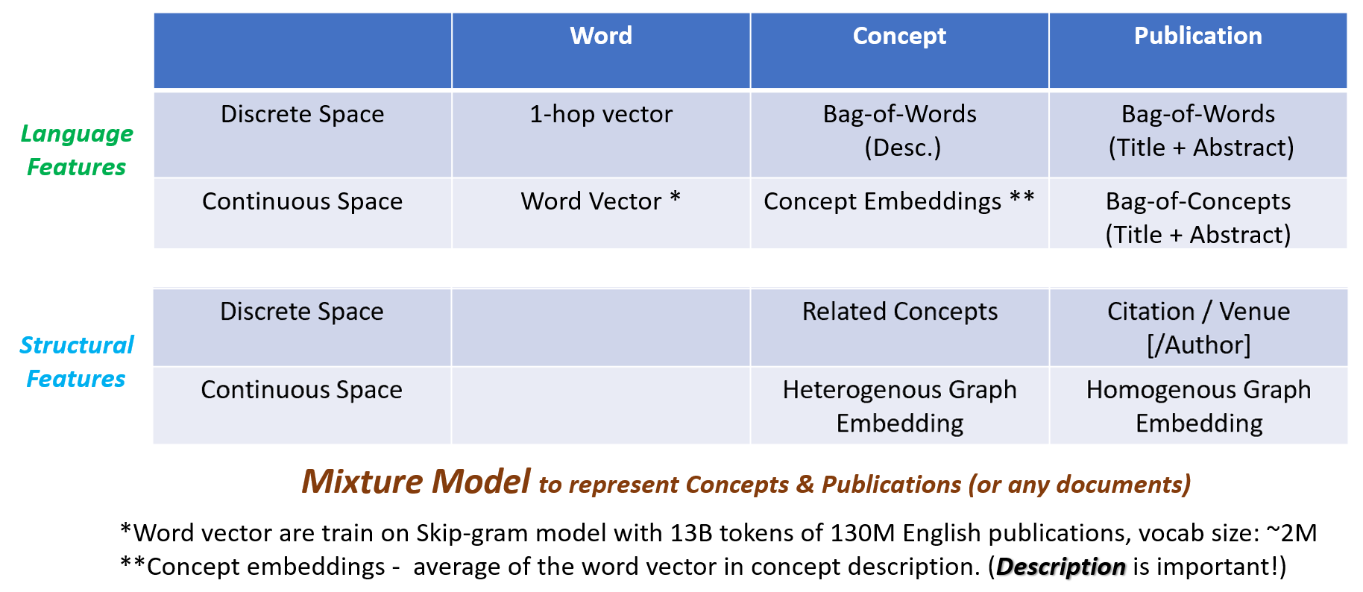
CORD-19 Topic Distribution
paper nodes in MAG
HOW: Paper- FieldsOfStudy
References: Shen, Zhihong, et al. “A Web-Scale System for Scientific Knowledge Exploration.” ACL, 2018.

Slide 18
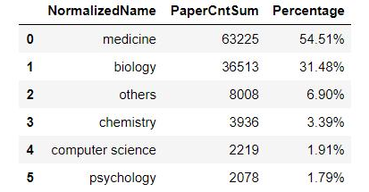
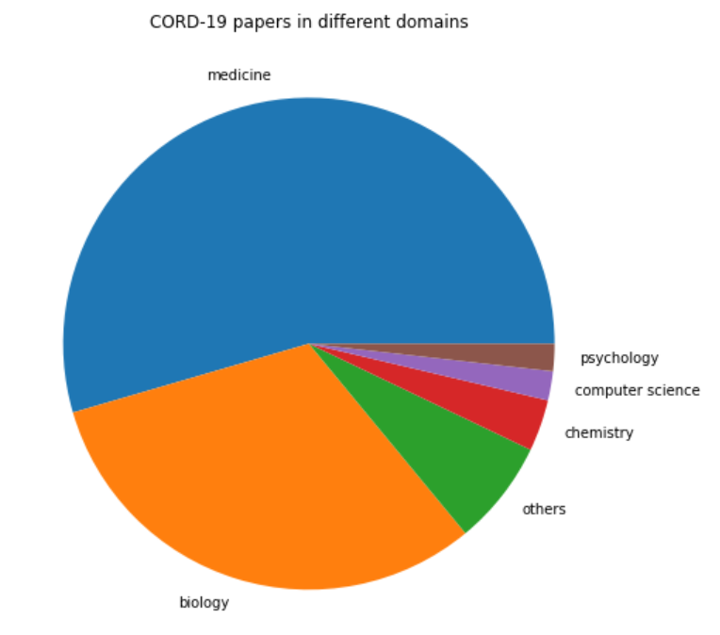
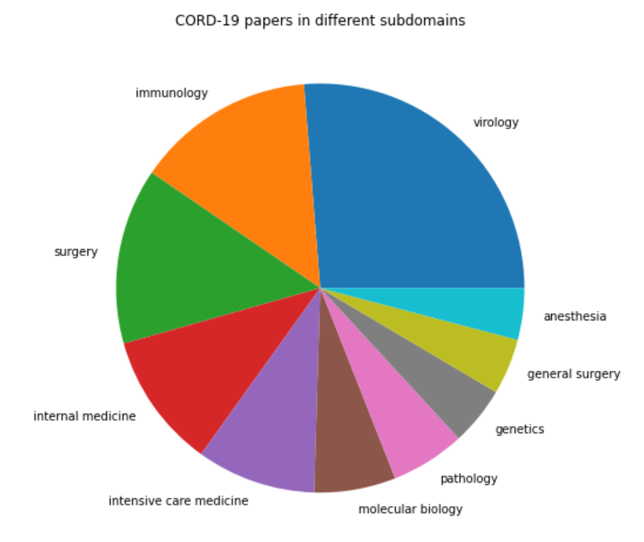
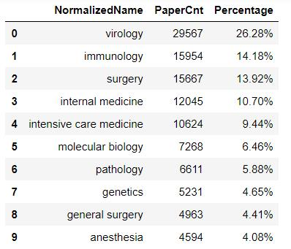
CORD-19 Topic Distribution
paper nodes in MAG
What are the CORD-19 papers talking about?
Top Domains
Top Sub-domains

Slide 19
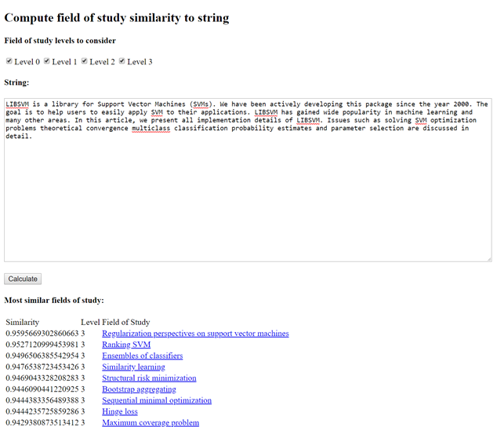
CORD-19 Topic Distribution
A document cannot map to a paper node in MAG
Language Similarity API
  WHAT
  WHY
  WHEN
Constructor
  LanguageSimilarity(resourceFolder)
Methods
  (Score) ComputeSimilarity( text, text )
  (Score) ComputeSimilarity( text, id )
  (Id, Score)[ ] GetTopFieldsOfStudy( text )
Documentation: https://docs.microsoft.com/en-us/academic-services/graph/language-similarity
Blogpost: Understanding documents by using semantics

Slide 20
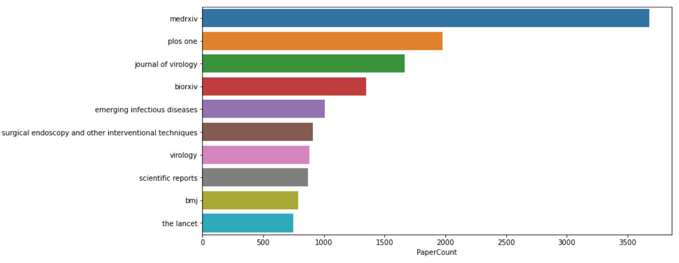
CORD-19 Publishing Venue Distribution
Where did the CORD-19 research publish?

Slide 21
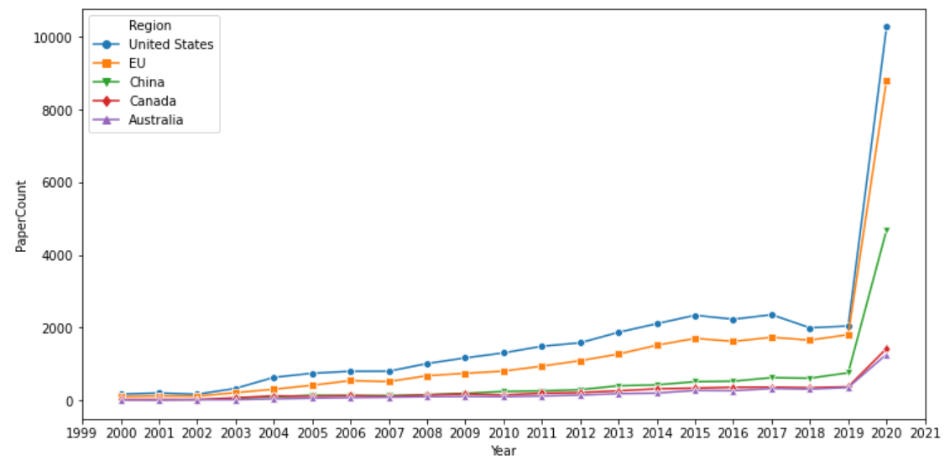
CORD-19 Geo & Temporal Distribution
Where did the CORD-19 research come from in past 20 years?

Slide 22
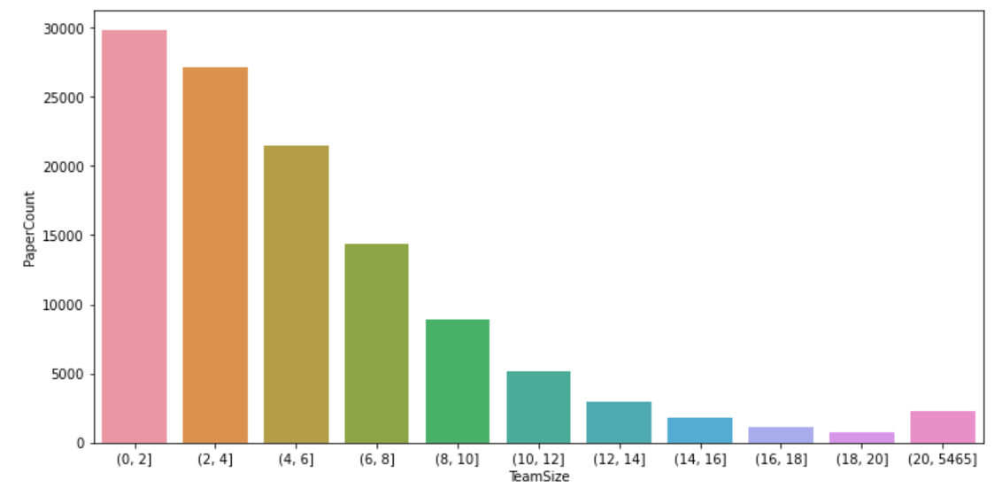
CORD-19 Team Size Distribution
Were the CORD-19 research conducted by small or large groups?

Slide 23
Module II – KG-based content understanding
KG (MAG) size and schema
Language Similarity API
Content understanding / Analytics
  Topic distribution
  Temporal & Geo distribution
  Venue distribution
  Team Size distribution
Code demo
CORD-19

Slide 24
Applications of Knowledge Graph: Academic Recommender Systems
Jianxun Lian

Slide 25
Knowledge-Aware Academic Recommender Systems
Background introduction
  Academic recommendations with knowledge graph
  Microsoft Recommenders
DKN: a knowledge-aware deep recommendation model
Hands on Building with Jupyter Notebooks
  Data preparations
  Model building
Evaluations

Slide 26








Academic recommendation with knowledge graph
Two applications of academic recommendations:
You May Cite:
author-to-paper recommendation
More Like This:
paper-to-paper recommendation
…
Citation history
Recommendations
Current paper
Recommendations

Slide 27
Research Papers with Knowledge Entities
Knowledge entities: field of study
  An area of academic concentration
Examples:
severe acute respiratory system syndrome scientific and anecdotal evidence for drug treatment
One Health approach in the South East Asia region: opportunities and challenges

Slide 28
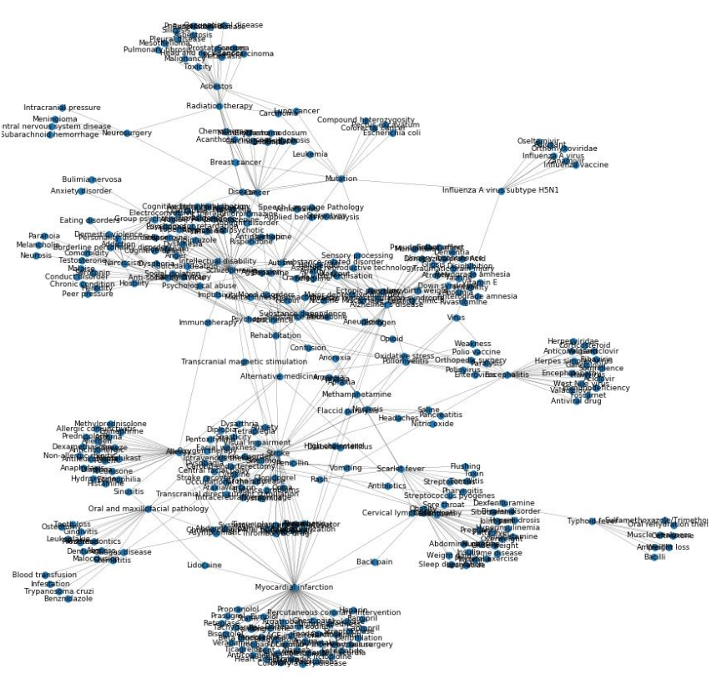
Field of study as a graph:

Slide 29
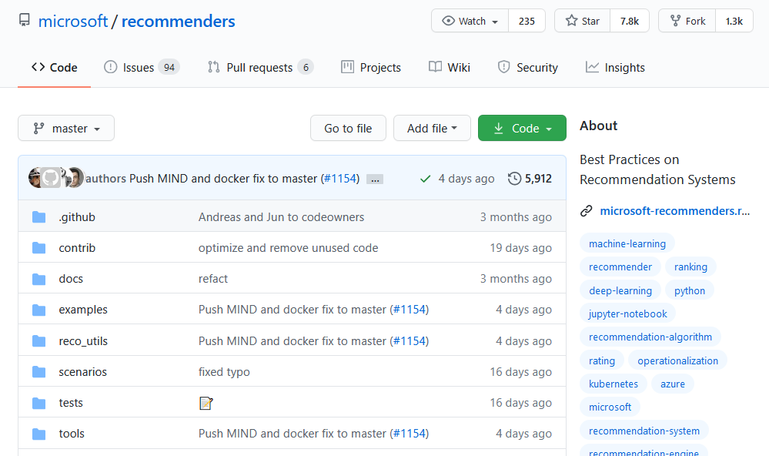
Microsoft Recommenders
https://github.com/microsoft/recommenders
A galaxy of examples and practices for building recommender systems.
  Helping researchers and developers to quickly select, prototype, demonstrate, and productionize a recommender system
  Accelerating enterprise-grade development and deployment of a recommender system into production

Slide 30
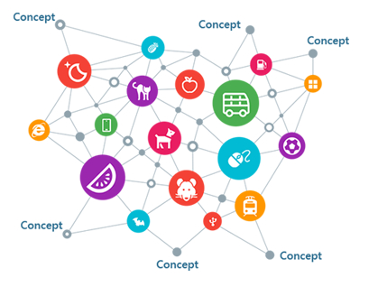


DKN: Deep Knowledge-Aware Network for News Recommendation
Click history
Knowledge graph
Elon Musk offers Tesla Model 3 sneak peek …
Google fumbles while Tesla sprints toward a driverless future …
Trump pledges aid to Silicon Valley during tech meeting …
General Motors is ramping up its self-driving car: Ford should be nervous …
Will the user click it?

Slide 31
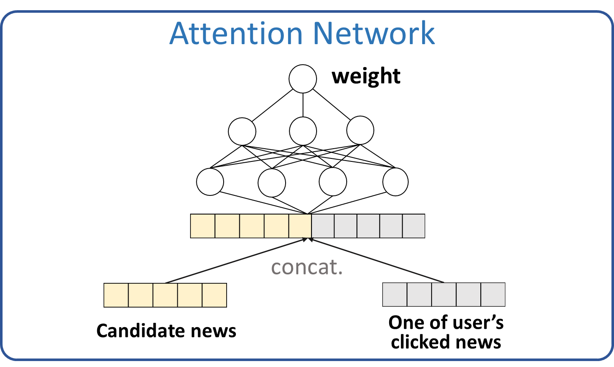
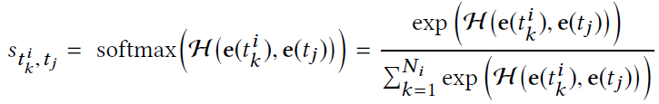
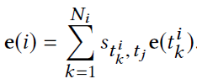




Attention-based User Interest Extraction
DKN
Click probability
element-wise $+$
element-wise $×$
concat.
User embedding
Attention net:
Candidate news embedding
Attention Net
User interest extraction:
KCNN
KCNN
KCNN
KCNN
CTR prediction:
Candidate news
User’s clicked news

Slide 32
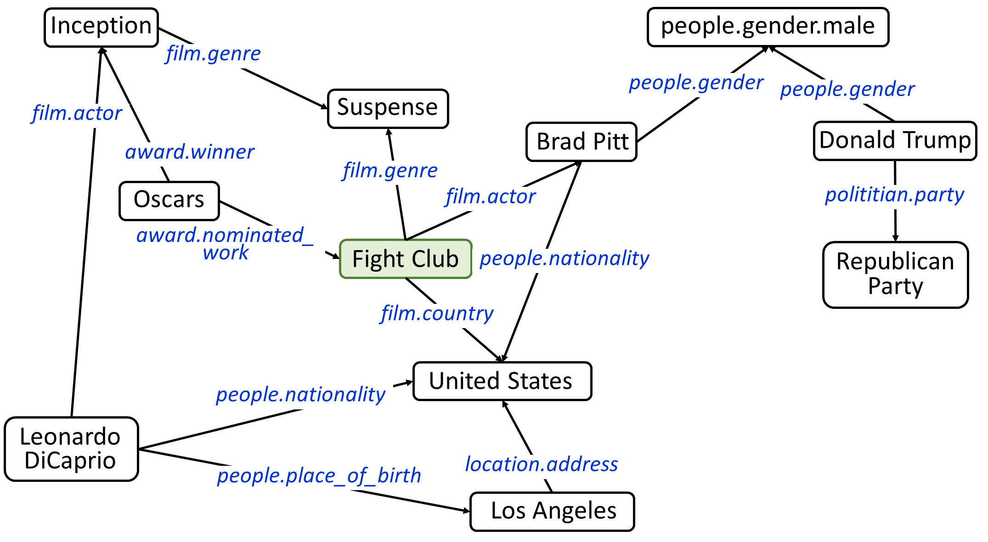
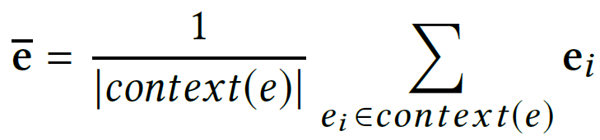
Knowledge representation
Context of entities “Fight Club”

Slide 33
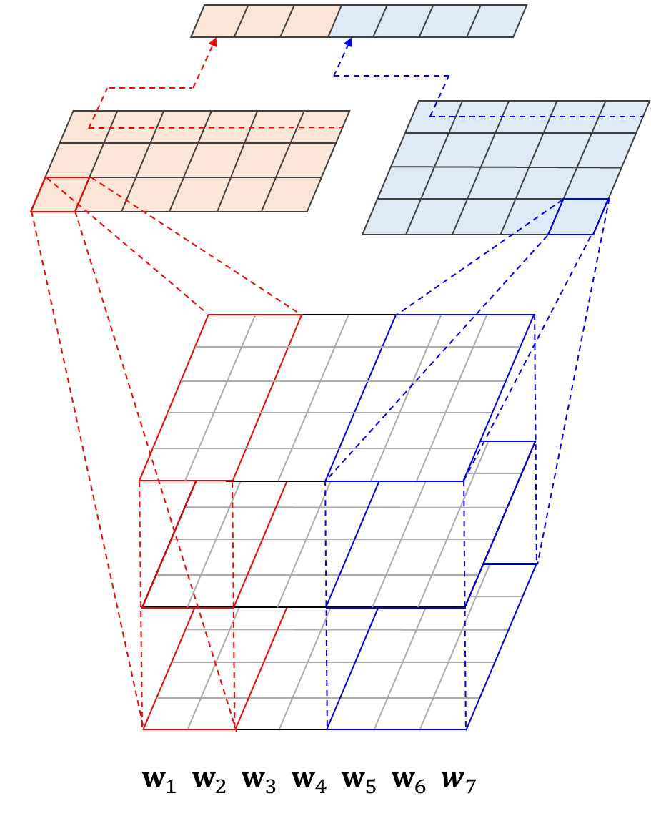
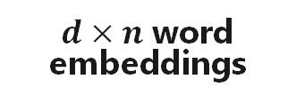




Knowledge-aware CNN (KCNN)
pooling
CNN layer
$d×n$ transformed context embeddings
$d×n$ transformed entity embeddings
multiple channels
$d×n$ word embeddings
$e_{1:n}=$ [ 1 1 1 0 0 0]
$w_{1:n}=$ [Galaxy Note 20 will launch Aug. 5]

Slide 34
Hands-on with Jupyter Notebooks
source: https://aka.ms/kdd2020-covid-demo

Slide 35
Operationalization of KG-based recommender system
Le Zhang and Miguel Gonzalez-Fierro

Slide 36
Operationalization of KG-based Recommender System
Introduction of industry-grade graph database, compute, and tool
Introduction of real-time scoring and ranking for recommendation system
Visualization of knowledge graph data on CORD-19 data set

Slide 37








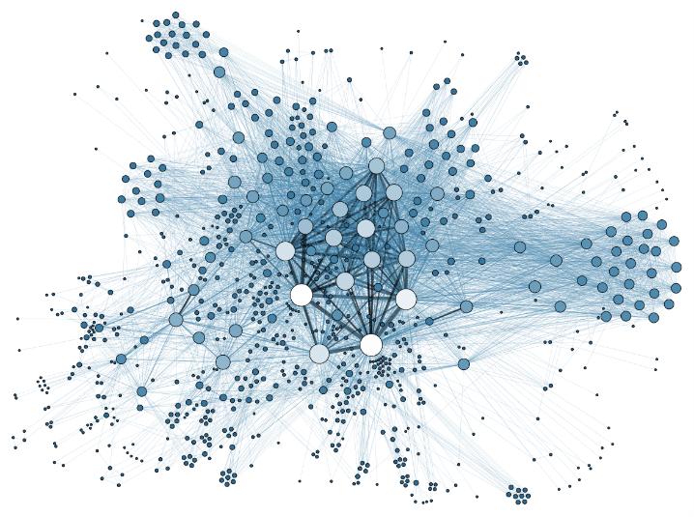





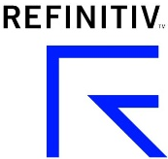




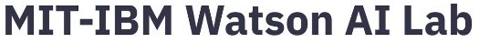
Customer experience
Targeted market campaign
Digital assistance
Wikipedia
Academic article search
Retail
Public good
Finance
Internet
Anti money laundering
Fraud detection
“Know-Your-Client”
Search engine
Recommendation
Customer segmentation
Key areas of application

Slide 38
Data
Algorithm
Resources
Evaluation
Operationalization
Time as efforts
https://papers.nips.cc/paper/5656-hidden-technical-debt-in-machine-learning-systems.pdf

Slide 39
Industrial applications on graph
Organization | Product | Category | Application | Use case | Application
Google | Google Knowledgh Graph | Commercial | Representation | Data search | Enterprise
Microsoft | Satori | Commercial | Representation | Data search (internal use) | Enterprise
Wikipedia | Wikidata | Open-source | Representation | Knowledge base for Wikipedia data | Enterprise
Leipzig University/University of Mannheim | DBPedia | Open-source | Representation | Semantically query relationships of entities extracted from Wikipedia | Enterprise
Lenovo | HyperGraph | Commercial | Representation/Learning | Knowledge graph-based analytics | Enterprise
Facebook | Graph Search | Commercial | Representation | Semantic search engine | Consumer
LinkedIn | LinkedIn Knowledge Graph | Commercial | Representation | Knowledge graph built on LinkedIn entities | Enterprise/Consumer
Amazon | Product Graph | Commercial | Representation | Knowledge graph for Amazon products | Enterprise
Pinterest | PinSage | Commercial | Learning | GCN based recommendation system | Consumer
Uber | - | Commercial | Representation/Learning | UberEats knowledge graph | Consumer
Airbnb | - | Commercial | Representation/Learning | Contextualization | Consumer

Slide 40
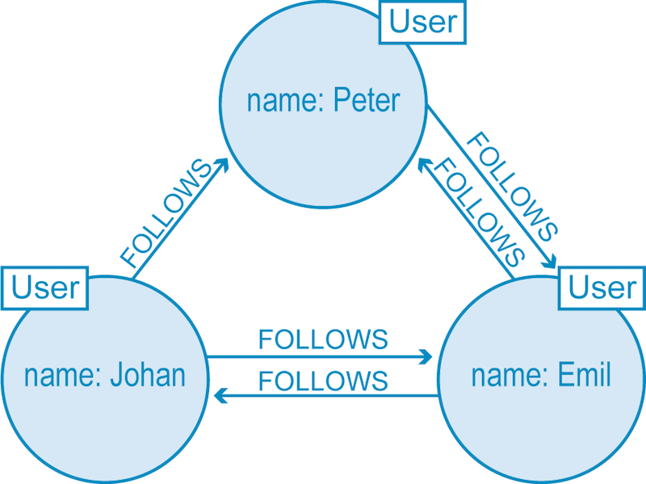
Graph database
Linear growth of data entries result in exponential growth of data connections
Graph database promises higher flexibility compared to tabular database
SELECT name FROM Person
LEFT JOIN Person_Department
ON Person.Id = Person_Department.PersonId
LEFT JOIN Department
ON Department.Id = Person_Department.DepartmentId
WHERE Department.name = "IT Department"
MATCH (p:Person)-[:WORKS_AT]->(d:Dept)
WHERE d.name = "IT Department"
RETURN p.name
Example graph that presents the connection of people in Twitter
Comparison between the SQL query (above) and graph query (below)
https://neo4j.com/developer/graph-db-vs-rdbms/

Slide 41
Graph database language
Cypher
  Declarative graph query language
  It is based on the property graph model that organizes data into nodes and edges
Gremlin
  Graph traversal language
  Supports imperative and declarative querying, host language agnosticism, etc.
SPARQL
  SPARQL Protocol and RDF Query Language
  RDF query language which is semantic

Slide 42
Query language platform
Query language | Supported platform | Technical features
Cypher | Neo4j, AgensGraph, and RedisGraph | Declarative graph query language It is based on the property graph model that organizes data into nodes and edges
Gremlin | Janus Graph, InifniteGraph, Azure Comos DB, DataStax Enterprise, and AWS Neptune | Graph traversal language Supports imperative and declarative querying, host language agnosticism, etc.
SPARQL | RDF4J, Jena, OpenLink Virtuoso | SPARQL Protocol and RDF Query Language RDF query language which is semantic

Slide 43
OSS
Product | Language | Framework | Github | Application | Technical features
Snap | C++/Python | Standalone | https://github.com/snap-stanford/snap | General purpose network analysis and graph mining library | Performance benefits from C++ implementation with flexibility of Python
DGL | C++/Python | Pytorch | https://github.com/dmlc/dgl | Python package built to ease deep learning on graph, on top of existing DL frameworks. | It makes implementing graph neural networks (including Graph Convolution Networks, TreeLSTM, and many others) easy while maintaining high computation efficiency.
Euler | C++/Python | Tensorflow | https://github.com/alibaba/euler | A distributed graph deep learning framework. | A large-scale distributed graph learning system. It can work with deep learning tools like TensorFlow or X-Deep Learning and support users to train models on very complex heterogeneous graphs with billions of nodes and tens of billions of edges.
graph_nets | Python | Tensorflow | https://github.com/deepmind/graph_nets | Graph network DL framework | Supports both TF and Pytorch
Spektral | Python | Tensorflow/Keras | https://github.com/danielegrattarola/spektral | Graph neural network with Keras and Tensorflow | Simple yet flexible for creating GNNs
AmpliGraph | Python | Tensorflow | https://github.com/Accenture/AmpliGraph | Python library for Representation Learning on Knowledge Graphs | Intuitive API, GPU-ready, and extensible
stellargraph | Python | networkx, Pandas, Numpy | https://github.com/stellargraph/stellargraph | Machine learning on graphs | Representation learning, classification of nodes/edges, link prediction, and interpretation of node classification

Slide 44
Real-time scoring in recommendation scenarios
Option 1: real-time look-up of pre-scored recommendation
Option 2: real-time scoring based on approximate similarity matching
Option 3: real-time scoring with optimization tricks

Slide 45
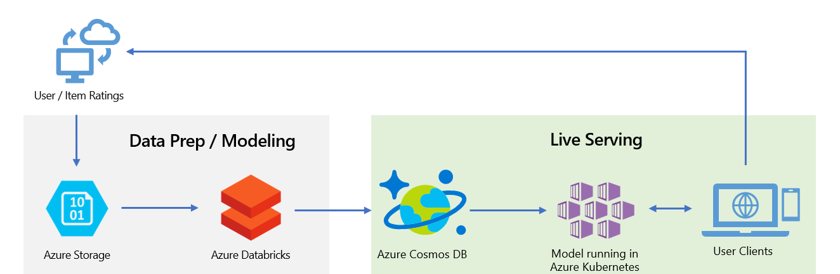
Real-time look up of pre-scored recommendations
API running on Kubernetes

Slide 46
Real-time scoring based on approximate similarity matching
Steps:
Compute user/item embeddings using any ML/DL algorithm.
Build the similarity index using KD-Trees, Locality-Sensitive Hashing (LSH) or similar.
Upload the similarity index to Azure Cosmos DB or instantiate directly the index in memory.
Generate an AKS API for scoring.
Given a user/item query, compute the query embedding.
With the approximate similarity model, find embeddings that are similar to the query embedding.
Retrieve the IDs of the similar objects.

Slide 47
Real-time scoring with optimization tricks
Optimization tricks:
request batching which merges adjacent requests from CPU to take advantage of GPU power
GPU memory optimization which improves the access pattern to reduce wasted transactions in GPU memory
Concurrent kernel computation which allows execution of matrix computations to be processed with multiple CUDA kernels concurrently.
source: http://arxiv.org/abs/1706.06978

Slide 48
Knowledge graph visualization demo
source: https://github.com/microsoft/recommenders/blob/master/examples/01_prepare_data/wikidata_knowledge_graph.ipynb
Notes:
import sys
sys.path.append("../../")
import pandas as pd
import networkx as nx
import matplotlib.pyplot as plt
from reco_utils.dataset.wikidata import (search_wikidata,
find_wikidata_id,
query_entity_links,
read_linked_entities,
query_entity_description)
results_list = pd.read_csv("https://recodatasets.blob.core.windows.net/covid/COVID_MAG_RelatedFields_NotGeneral.txt?sp=r&st=2020-07-22T10:17:49Z&se=2021-07-22T18:17:49Z&spr=https&sv=2019-12-12&sr=b&sig=CofcvD5qc%2FBAguVHpHsbc1StIYU3UpkUmTPiz21T3KM%3D",
sep="\t",
names=["original_entity", "name", "linked_entities", "name_linked_entities"])
print(results_list.shape)
results_list = results_list.head(500)
results_list.head()
G = nx.from_pandas_edgelist(results_list, 'original_entity', 'linked_entities')
target_names = results_list[["linked_entities", "name_linked_entities"]].drop_duplicates().rename(columns={"linked_entities": "labels", "name_linked_entities": "name"})
source_names = results_list[["original_entity", "name"]].drop_duplicates().rename(columns={"original_entity": "labels"})
names = pd.concat([target_names, source_names])
names = names.set_index("labels")
names = names.to_dict()["name"]
plt.figure(figsize=(12,12))
pos = nx.spring_layout(G)
nx.draw(G,pos, node_size=60,font_size=9, width = 0.2)
nx.draw_networkx_labels(G, pos, names, font_size=9)
plt.show()

Slide 49
Closing

Slide 50
Key takeaways
A general understanding about knowledge graph technology
An in-depth analytics about the CORD-19 data set and its application
A walk-through of building a paper recommender with MAG and CORD-19 data set
An overall understanding of operationalizing graph-based recommender systems with industry-grade tools

Slide 51
References
Hongwei Wang et al, “DKN: Deep Knowledge-Aware Network for News Recommendation”, ACM WWW 2018.
Andreas Argyriou, Miguel González-Fierro, and Le Zhang, “Microsoft Recommenders: Best Practices for Production-Ready Recommendation Systems”, ACM WWW 2020.
Shen, Zhihong, and Dong, Yuxiao. From Graph to Knowledge Graph Algorithms and Applications. edX, 2019. https://www.edx.org/course/graphsto- knowledgegraphs-3
Tang, Jie, and Dong, Yuxiao. Representation Learning on Networks: Theories, Algorithms, and Applications. WWW, 2019. https://www2019.thewebconf.org/tutorials.
Le Zhang et al, “Building production-ready recommendation systems at scale”, KDD 2019.
Perozzi, Bryan, Rami Al-Rfou, and Steven Skiena. “Deepwalk: Online learning of social representations.” Proceedings of the 20th ACM SIGKDD international conference on Knowledge discovery and data mining. 2014.
Hamilton, Will, Zhitao Ying, and Jure Leskovec. “Inductive representation learning on large graphs.” Advances in neural information processing systems. 2017.
CORD-19, url: https://pages.semanticscholar.org/coronavirus-research
Microsoft Academic Graph Documentation, url: https://docs.microsoft.com/en-us/academic-services/graph/
Microsoft Academic Graph Application on COVID-19 research, url: https://github.com/microsoft/mag-covid19-research-examples
Understanding Documentation By Using Semantics, url: https://www.microsoft.com/en-us/research/project/academic/articles/understanding-documents-by-using-semantics/
Wang, Kuansan, et al. “Microsoft Academic Graph: When Experts Are Not Enough.” Quantitative Science Studies, vol. 1, no. 1, 2020, pp. 396–413.
Wang, Kuansan, et al. “A Review of Microsoft Academic Services for Science of Science Studies.” Frontiers in Big Data, vol. 2, 2019.

Slide 52
Q & A

