Slide 1
Build Enterprise-grade Recommendation System at Scale
Le Zhang | Data Scientist @ Microsoft

Slide 3
Outline
Impact of recommendation technology.
Key topics in productizing applicable and scalable recommendation system.
“Fallacies and pitfalls”.

Slide 4
“35% of what consumers purchase on Amazon and 75% of what they watch on Netflix come from recommendations algorithms”
McKinsey & Co

Slide 5
Recommendation everywhere
Notes:
The AI transformation
Making AI real for customers
How does AI help you? How can you use AI to enable your business today? We have 3 core scenarios that our customers are using today to transform their businesses with AI.
First, we have conversational or digital agents. By 2025, 95% of customer interactions will take place via bots. Bots are a crucial customer engagement tool to build customer loyalty and a competitive advantage for businesses.
Second, we have intelligent apps. Intelligent Apps is about the massive shift around developers and enterprises creating the business apps of the future built around intelligence and data. 75% of apps will be infused with AI by end of 2018.
Third is about transforming core business processes with AI. Every business process in every industry will be transformed by AI. Just as software became the key competitive advantage for companies across industries – the use of AI to get smarter, more agile, and get to market faster will be critical.

Slide 6
Recommendation everywhere
Brand/news/product recommendation
Business metric prediction
Customer segmentation and personalization
Indirectly drive revenue by increasing customer engagement, networking effect, etc.
Directly drive revenue through ad clicks, internet traffics, etc.
Indirectly drive revenue by precisely reaching customers with market campaign or product.
Notes:
The AI transformation
Making AI real for customers
How does AI help you? How can you use AI to enable your business today? We have 3 core scenarios that our customers are using today to transform their businesses with AI.
First, we have conversational or digital agents. By 2025, 95% of customer interactions will take place via bots. Bots are a crucial customer engagement tool to build customer loyalty and a competitive advantage for businesses.
Second, we have intelligent apps. Intelligent Apps is about the massive shift around developers and enterprises creating the business apps of the future built around intelligence and data. 75% of apps will be infused with AI by end of 2018.
Third is about transforming core business processes with AI. Every business process in every industry will be transformed by AI. Just as software became the key competitive advantage for companies across industries – the use of AI to get smarter, more agile, and get to market faster will be critical.

Slide 7
Key pillars of recommendation technologies
Data
Algorithm
Resources
Evaluation
Operationalization (O16N)
Time as efforts
https://papers.nips.cc/paper/5656-hidden-technical-debt-in-machine-learning-systems.pdf

Slide 8
Implicit preferences.
Computation on sparse matrix.
Data representation.
Time series preferences.
Similarity-based algorithm.
Neighborhood-based algorithm.
Stratification on data splits.
Temporal partition of data.
Missing-at-random.
Long tail distribution.
Funk Singular Value Decomposition.
SVD++.
Restricted Boltzmann Machine.
Deep autoencoder.
Data
Algorithm
Wide & deep.
FM / FFM.
xDeepFM.
Attention mechanism.
Session-based model.
Embeddings.
“Accuracy” based metrics (RMSE, etc.)
Ranking system metrics.
Novelty/Coverage/Serendipity.
Evaluation
O16N
Experimentation protocol
Data splitting
Cold users/items.
Distributed database.
Graph database.
Data lake.
No-SQL database.
Web/mobile application.
Container/K8S cluster
Multi-arm bandit.
Grey-box test, A/B testing, etc.
Business metrics (CTR, impression rate, conversion rate, GMV, DAU/MAU, etc.)
Distributed and parallel computing.
GPU acceleration.
Streaming.

Slide 9
Key pillars of recommendation technologies
Implicit preferences.
Computation on sparse matrix.
Data representation.
Time series preferences.
Data
Algorithm
Evaluation
O16N
Stratification on data splits.
Temporal partition of data.
“Missing-at-random”.
Long tail distribution.
https://arxiv.org/ftp/arxiv/papers/1205/1205.2618.pdf
http://yifanhu.net/PUB/cf.pdf
https://link.springer.com/chapter/10.1007/978-1-4899-7637-6_8
https://arxiv.org/ftp/arxiv/papers/1206/1206.5267.pdf

Slide 10
Key pillars of recommendation technologies
Similarity-based algorithm.
Neighborhood-based algorithm.
Funk Singular Value Decomposition.
SVD++.
Restricted Boltzmann Machine.
Deep autoencoder.
Data
Algorithm
Evaluation
O16N
LR.
XGBoost.
LightGBM
Wide & deep.
FM / FFM.
xDeepFM.
Attention mechanism.
Session-based model.
Embeddings.
https://github.com/yueguoguo/production-ready-recsys
https://www.microsoft.com/en-us/research/lab/microsoft-research-asia/articles/personalized-recommendation-systems/?from=timeline&isappinstalled=0

Slide 11
Fallacies and pitfalls
“Complex algorithms are always preferred.”
Run time performance
Run time performance
Algorithm #1
Algorithm #2
Explainability
Scalability
Explainability
Scalability
Model performance
Model performance
https://www.microsoft.com/en-us/research/lab/microsoft-research-asia/articles/personalized-recommendation-systems/?from=timeline&isappinstalled=0
https://arxiv.org/abs/1804.11192
https://arxiv.org/abs/1706.07639

Slide 12
Key pillars of recommendation technologies
“Accuracy” based metrics (RMSE, etc.)
Ranking system metrics.
Novelty/Coverage/Serendipity.
Experimentation protocol
Data splitting
Cold users/items.
Data
Algorithm
Evaluation
O16N
Multi-arm bandit.
Grey-box test, A/B testing, etc.
Business metrics (CTR, impression rate, conversion rate, GMV, DAU/MAU, etc.)
https://link.springer.com/chapter/10.1007/978-1-4899-7637-6_8
https://dl.acm.org/citation.cfm?id=3240354

Slide 13
Fallacies and pitfalls
“Good metrics indicate good recommenders.”
Accuracy
Ranking
Online metrics
Revenue
Order of the recommended item list.
Correlation?
Correlation?

Slide 14
Key pillars of recommendation technologies
Distributed database.
Graph database.
Data lake.
No-SQL database.
Data
Algorithm
Evaluation
O16N
Distributed and parallel computing.
GPU acceleration.
Streaming.
Web/mobile application.
Container/K8S cluster
https://kubernetes.io/
https://dl.acm.org/citation.cfm?id=214456
https://spark.apache.org/docs/latest/mllib-collaborative-filtering.html
https://docs.microsoft.com/en-us/azure/cosmos-db/introduction

Slide 15
Fallacies and pitfalls
“Science first, engineering second.”
https://customers.microsoft.com/en-au/story/asos-retail-and-consumer-goods-azure

Slide 16
Distributed DB needed?
Parallel / distributed?
No
DSVM
App service needed?
Yes
Yes
O16N pipeline
CosmosDB
Databricks
Yes
DSVM (GPU)
Yes
ACI/AKS
Workflow
Data
Recommender
Evaluator
Chrono split
NN-based
DeepRec
Diversity
Stratified split
Yes
Content-based
No
Regression
Ranking
No
Yes
Random split
Even richer feature set?
ALS
No
Rating
Analyitcs pipeline
Yes
No
Yes
Time dependent?
collaborative filtering
SAR
Diversity metrics?
No
Yes
No
No
Yes
No
No
Cold start user/item?
User/item features?
Similarity based?
Ranking evaluation?

Slide 17
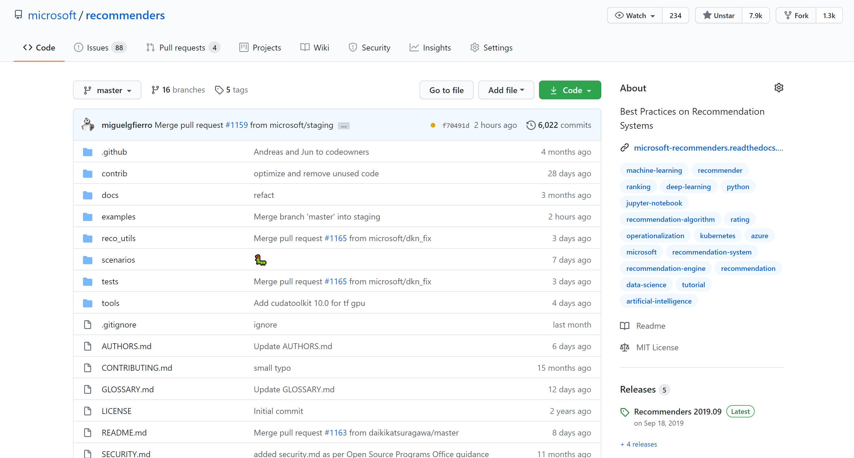
Microsoft/Recommenders
https://github.com/Microsoft/Recommenders

Slide 18
Q & A

